Slide 1
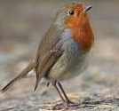


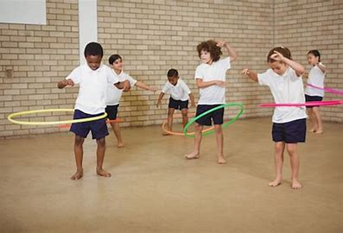


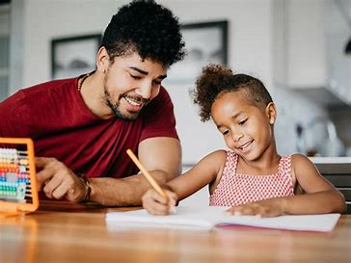
Welcome to Year 2
Just to remind you PE days this term will be on Monday (indoors) and Wednesday (outdoors).
Reading books will be changed every Friday. In Year 2, we are starting to focus on the children's understanding of the text.
If you haven’t joined our class dojo page, please let us know and we can resend the link!
Any home time arrangements need to be written in the contact book – this includes everyone except parents who pick up. Please call the office if there is a change.
Homework will be given out on a Friday. It will be based on the learning we have covered during the week. Please return by the following Wednesday.
Please send your child with a named, plastic water bottle.

Slide 2
Our themes
Terms 1 – Where is Europe?
Term 2 - What was life like in Medieval Britain?
Term 3 – What is climate and how is it changing?
Term 4 – How did the Romans impact Europe?
Terms 5 – How does wealth impact architecture?
Term 6 – What was the legacy of the Ancient Greeks?

Slide 3
PE
We expect every child to participate in PE.
They need to be prepared by coming into school in their full PE kit.
This includes trainers (not plimsolls), white or house colour t-shirt, jumper, and shorts or tracksuit bottoms.
Please make sure earrings and all jewellery is removed and long hair is tied back prior to coming to school on PE days otherwise children will not be able to partake in activities set. Instead, they will be given a role i.e. coach, teacher’s assistant, time keeper.
Our PE (subject to weather,) are Monday and Wednesday this term.

Slide 4
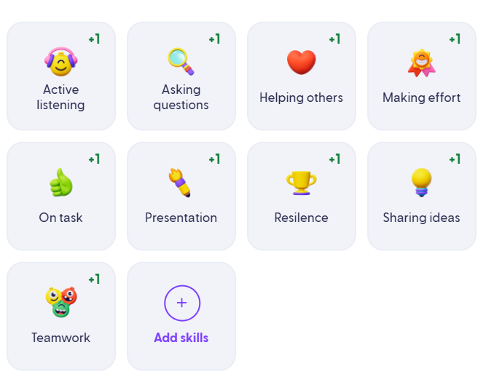
Behaviour expectations
All children are encouraged to do their best learning and we will always endeavour to support children to the best of our ability.
Children will be following the Good to be Green system to encourage effective behaviour for learning.
Dojo points are used to reward a child who demonstrates key learning skills, such as resilience, active listening and demonstrating success with their learning.

Slide 5

Behaviour expectations
These are our values and promises that we expect the children to follow at school. If children show these values, they will be given a recognition card which goes into their good to be green slot.

Slide 6

Every day a pupil is selected at random and at the end of the day, if that child has not had a yellow or red card, they earn the class a secret pupil point. The children can then “spend” these points on a class reward throughout the term or at the end depending on how many points they want to spend at a time.

Slide 7
Phonics and Spelling
We have started this term by picking up from where Year 1 ended with their phonics learning and have moved to our spelling programme called spelling shed.
Those children who did not yet pass their phonics screening will be supported through small group interventions and will be rechecked.
Below are some links which show the ELS scheme we follow and our class page with pronunciation of phonemes.
https://essentiallettersandsounds.org/app/training/
https://www.mierscourt-that.org.uk/classpages/year2

Slide 8
Reading
Children will all have a reading book and their orange reading record. Please send both into school daily.
We endeavour to read with each child 1:1 once a week.
Children’s books are levelled according to their phonics and fluency.
We do keep a careful eye on levelling and will move the children once they are showing fluency and an understanding of what they have read.
ELS (the phonics scheme that we follow) recommend that children need to read their book a few times to develop fluency and understanding. The first read should be focused on decoding the words, the second read should focused on developing fluency and expression and the third/fourth read is developing their understanding of the story. This could include simple questions based on what they have read.

Slide 9
