Slide 1
Welcome to year 4!

Slide 2
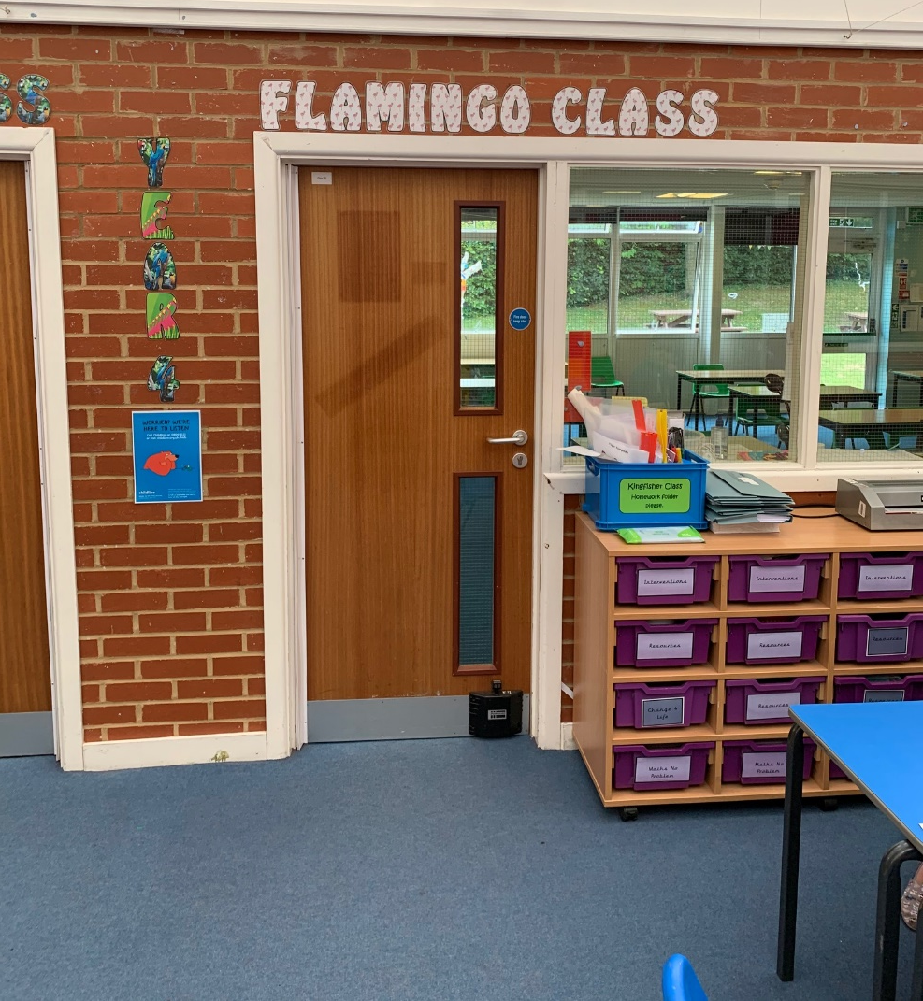
In September I will be in Flamingo class.

Slide 3
My Teacher will be Miss Wood.

Slide 4
The LSAs in year 4 will be Mrs Wright and Mrs Herrod.
Mrs Gillam will also be in year 4.

Slide 5
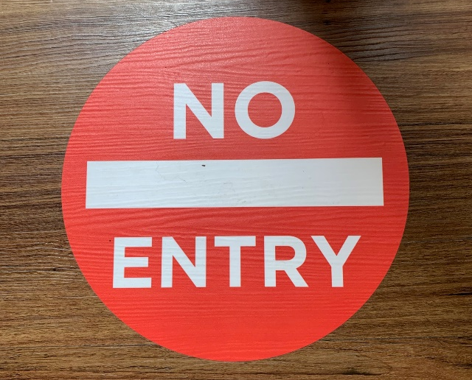
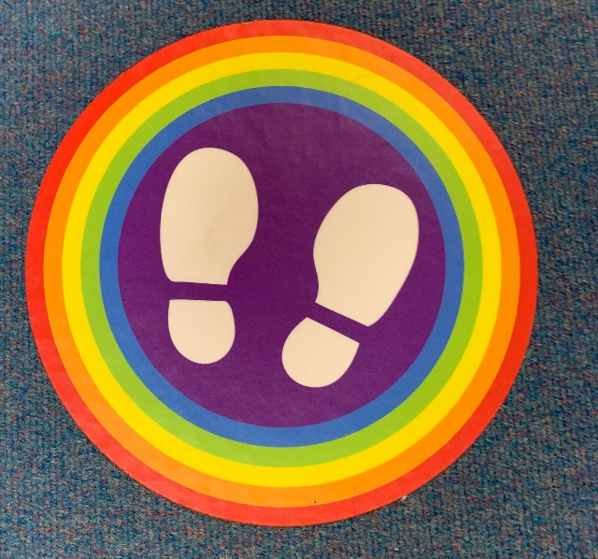
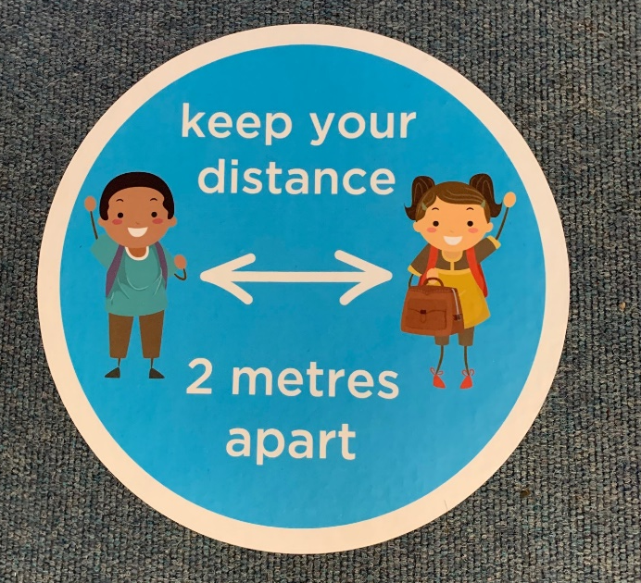
When you come back to school, there may still be some signs and posts that
you have not seen before.
They are there to help you find your way around the school safely, whilst keeping a
safe distance.

Slide 6
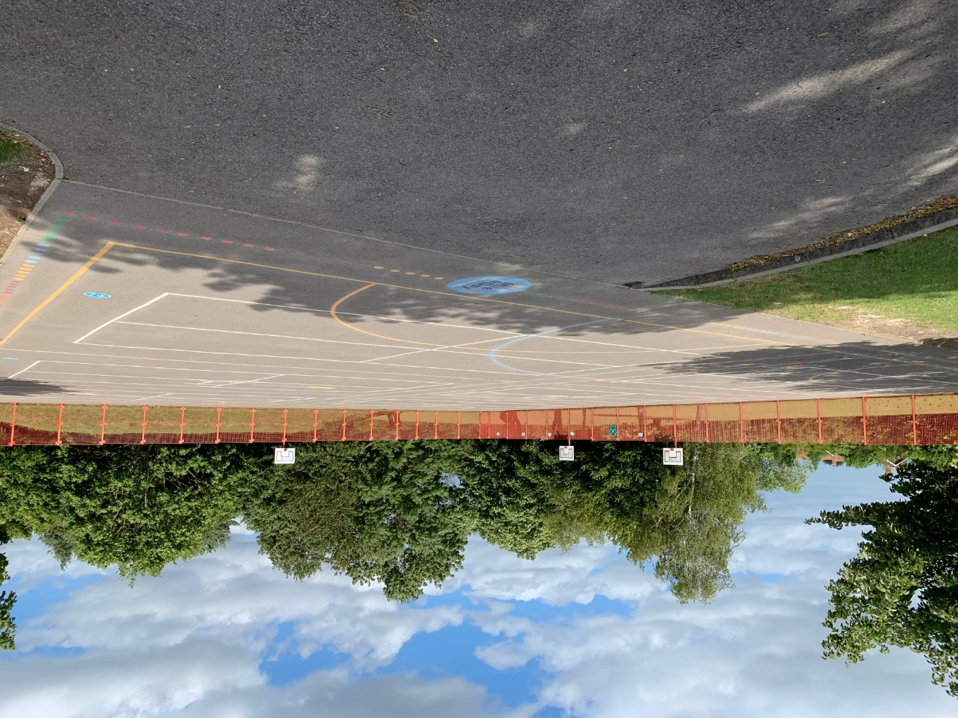
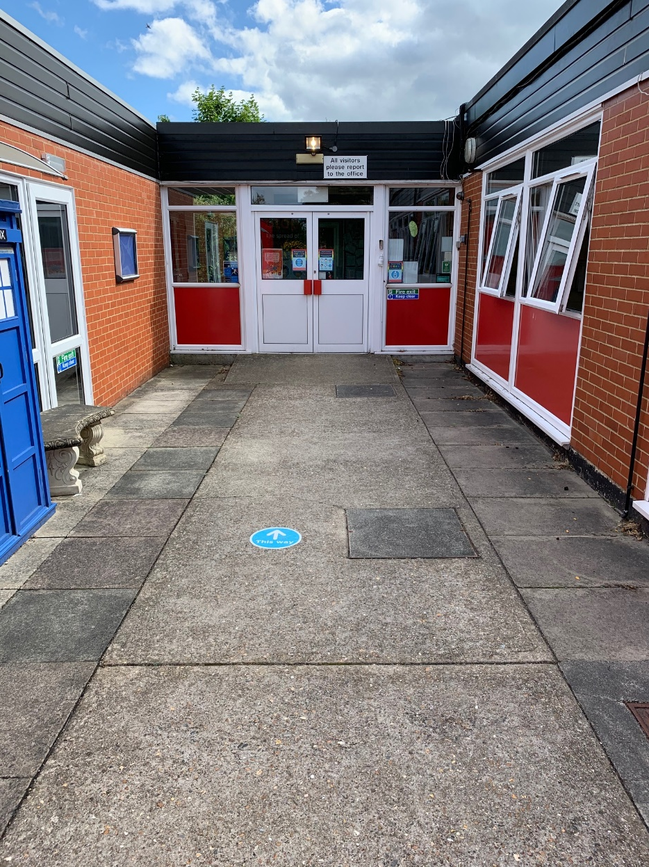
We come in to school through the
main entrance.
This is our playground.

Slide 7
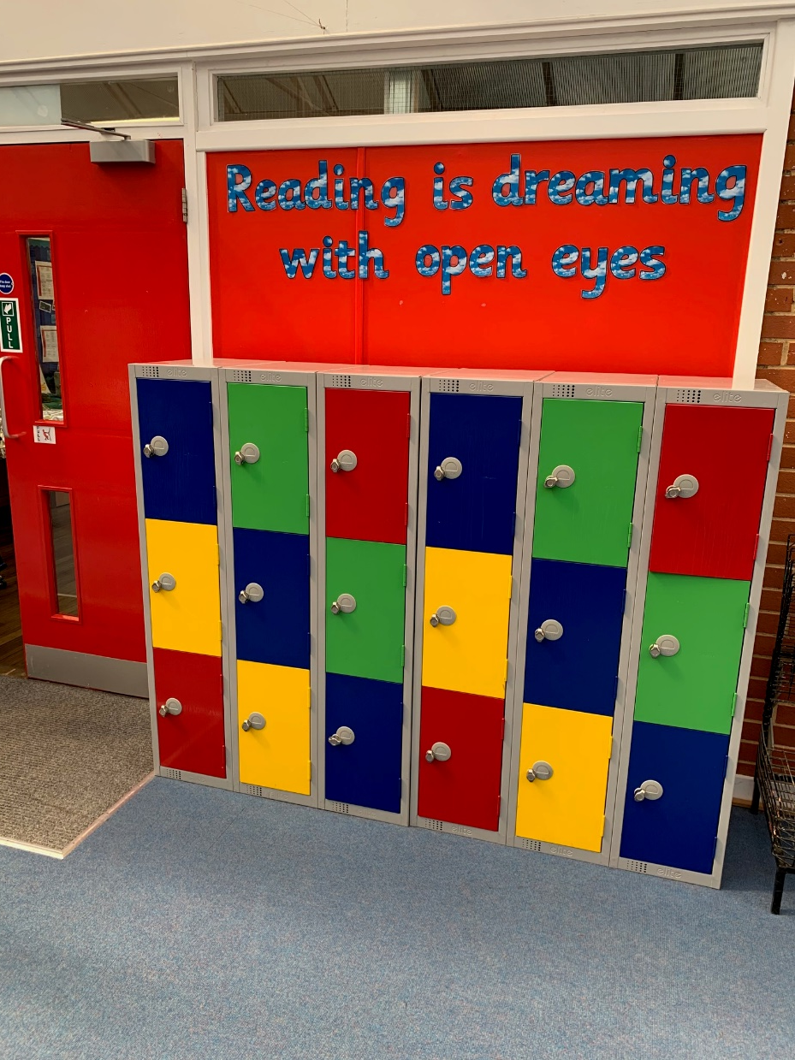
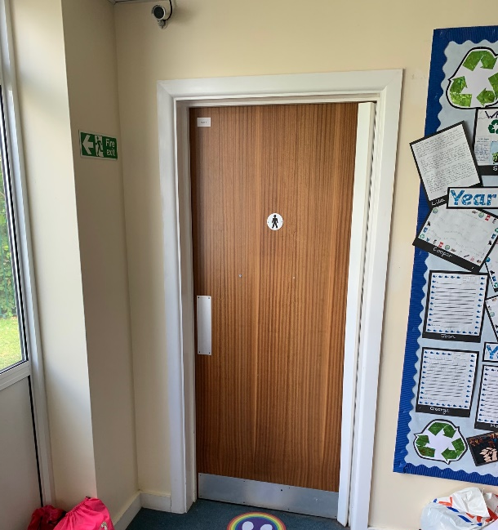
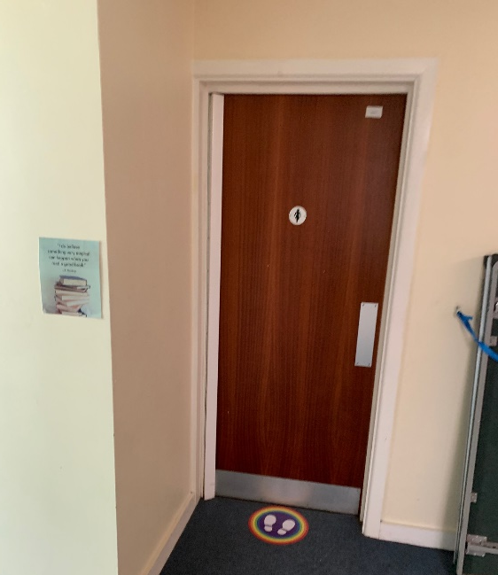
These are the year 4 toilets.
These lockers are where I will put my coat and bag.

Slide 8
Things to look forwards to in year 4…
Exciting new topics, exploring Vikings, Ancient Greece, The oceans and more!
The year 4 production.
Lots of opportunities to further develop your learning and skills.
You will have the opportunity to take up an instrument.
And much more!
We look forwards to seeing you in September!

