Slide 1
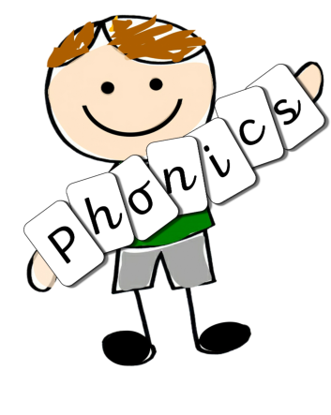
Phonics Interventions

Slide 2
ELS teaches children to read using a systematic synthetic phonics approach.
It is designed to be used as part of an early learning environment that is rich in talk and story, where children experience the joy of books and language whilst rapidly acquiring the skills to become fluent independent readers and writers.
ELS teaches children to:
Decode by identifying each sound within a word and blending them together to read fluently.
Encode by segmenting each sound to write words accurately.
We know that for children at the end of Key Stage 1 to achieve the age-related expectations, they need to read fluently at 90 words per minute.

Slide 3
ELS has a ‘Keep up’ Rather than ‘Catch up’ approach.
A whole-class approach ensures that all children benefit from the full curriculum.
Children who encounter difficulties are supported by the teacher throughout the lesson, and where further support is required, ELS has three interventions to ensure that any learning gaps are quickly filled.

Slide 4
How do we support children who find phonics challenging?
Since interventions are delivered within the lesson by the teacher, any child who is struggling with the new knowledge can be immediately targeted with appropriate support, usually during the Apply activity.
We know that children – especially those with educational difficulties – learn better in a mixed-ability environment where their learning is scaffolded not only by the teacher and support staff but also by their peers. In this most fundamental area of learning – learning how to read – this support is even more vital, not only to their success but also to the outcomes of the programme as a whole.
Over-learning, alongside a range of Apply activities, helps children who acquire phonic knowledge more slowly to succeed.
If children require further support to achieve the outcomes of the lesson and keep up with the pace of the programme, ELS has three interventions that are to be delivered on a one-to-one basis: oral blending, GPC recognition and blending for reading.
These are intended to be short and concise and last no longer than five minutes. They can be delivered in isolation, or different interventions can be used together to support children each day. This helps ensure that children do not spend excessive time outside of the classroom or in group intervention sessions where they are removed from the rest of the curriculum.

Slide 5
Where there are children with an EHCP or for whom we are adapting our curriculum to meet their needs, we make adaptations to ELS.
This may mean that we break the lesson into smaller ‘chunks’ to support their concentration or that we adapt the pace at which the programme is taught.
We also adapt resources to make them larger, more simplistic or engaging – linking to their interests.

Slide 6
Oral blending Intervention
This intervention supports children struggling with oral blending and those with any auditory processing difficulties.
It allows children who require additional practice of this skill to have short bursts of oral blending to consolidate their understanding and support their auditory discrimination.
Lets take a look at the video!

Slide 7
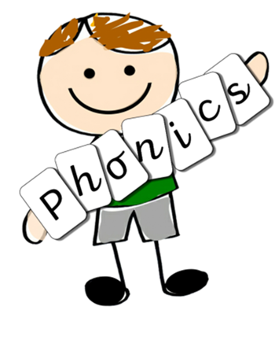
GPC Recognition Intervention
This intervention involves deliberate over-learning, re-teaching and repeated exposure. It will support children with English as an additional language, those new to ELS, those with additional needs and those with auditory processing weaknesses or a fluency block.
Before this intervention, teachers will need to assess the child’s grapheme knowledge and be aware of any sound gaps.
The intervention follows a similar structure to the whole-class session: reviewing previously taught sounds using grapheme cards, teaching the sound/grapheme that needs reinforcing, and applying this skill by word-building and reading.
Let’s watch the video.

Slide 8
What can parents do to support their child at home?
Look for phonics opportunities in everyday life without making it a chore.
Amazon sell ELS home resources.
Read regularly.
Support you child with their phonics homework.
Appeal to your children’s interests, make games.
Look at the gaps sent home and practise these regularly.
Use the strategies that we use in school such as robot arms and blending hands, spelling sequence

