Slide 2


What is the Year 1 Phonics Screening Check?
The Phonics Screening Check will take place in year 1, the week beginning the 8th June.
Children throughout the country will take the test during the same week.
If your child is absent from school during that week, they will take it another date before Friday 19th June.
Children in year 2 will also take the check if they did not achieve the required outcome when in year 1 or if they have not taken the test before.
It is up to individual headteachers to decide whether some pupils within school might be exempt from taking the Phonics Screening Check. This decision will be shared with parents prior to the screening taking place.
The Phonics Screening Check is designed to allow teachers to assess whether children have made good progress within their phonics learning and if they have reached an expected standard.
It can help to identify gaps in children’s phonics knowledge and gives the school a picture of where children may be excelling or requiring extra support.

Slide 3
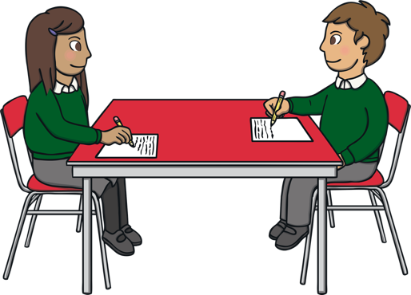
What Happens During the Screening?
The Phonics Screening Check is designed not to be stressful for your child.
We have prepared children well for it and it will not be referred to as a ‘test’.
The screening will take around 10 minutes per child, although children are allowed to work at their own pace and there is no time limit.
If your child is struggling, the teacher can stop the check.
Each child will sit one-to-one with an adult and will be asked to read the screening words out loud.

Slide 4


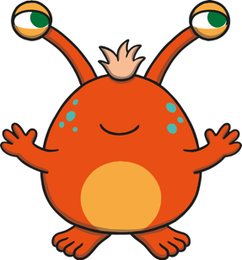
The screening contains 40 words.
Some of these words are real words and some are ‘non-words’, ‘nonsense words.’ (Also referred to as ‘alien words’ or ‘pseudo words’.)
Children will be prepared for the fact that some of the words will not be real words and these words are identifiable during the test by having a small image of an alien next to them.
These ‘non-words’ are important because all children will need to use their decoding skills to read them as they will have not been learnt by sight.

Slide 5
Examples of the screening words
This is what the screening check will look like for the children. This is an example of some Level 3 and Level 4 words.

Slide 6


Reporting to Parents and Carers
We must report the results of the Phonics Screening Check to parents and carers before the end of the summer term. It will be included in your child’s end of year report.
We will advise you on how your child has scored and if your child has struggled to meet the expected standard in the test.
We will also tell you what support has been put in place to help your child.
Children who do not pass the Phonics Screening Check in year 1 will go on to retake it in year 2, unless there are mitigating circumstances.

Slide 7
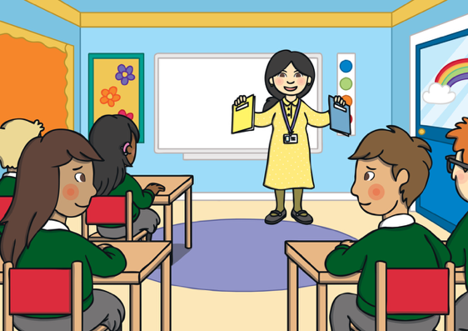
How Are the Results Used?
The data collected from the screening is used within the school to provide assessment of children’s decoding skills. It is also a requirement that the results are submitted to the Department For Education, where it is used to collate information about the standards of phonics across the country. The data might also be used during a school Ofsted inspection.

Slide 8
How Can you help?
Parents and carers play a vital role in fostering a love of books and an enjoyment of reading in their children.
Look out for the Phoneme Gaps that get sent home and practise them daily.
Read with your child as often as possible. Read to them and get them to read to you.
When you listen to your child read, allow them time to attempt to decode unfamiliar words using the strategies they have learnt in schools, before jumping in to help them. If they continue to struggle you may support them by pointing out the sounds (not the letters) in a word. For example, the word ‘sheep’ would be ‘sh-ee-p.’
Complete phonics homework. Also, use games – phonics play.
Encourage them with plenty of praise and try to make your reading time enjoyable.

Slide 9

Play lots of word games like ‘I Spy’ and ‘Hangman’.
When you are out and about, ask your child to read traffic or shop signs. Allow them time to decode the words before stepping in.
Keep reading activities short. It is much better to read little and often.
Stop before your child becomes bored and restless and encourage them with lots of praise.
The most important thing is to remember to have fun!
Always remember you can talk to your child’s teacher. They will be able to inform you of where your child might need extra support and what you can do to help them.

