Slide 1
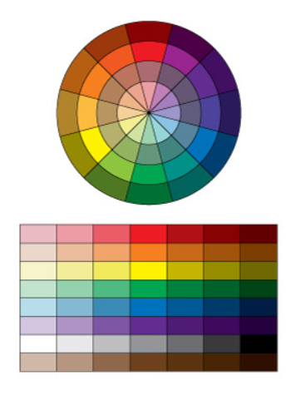
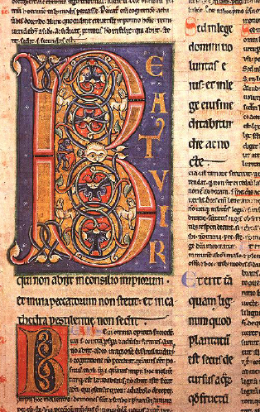
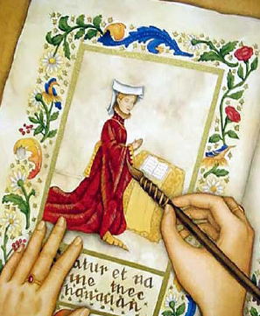
Year 5 : Art & Design – Colour mixing (paint)
Subject Specific Vocabulary
gold leaf | gold that has been beaten into a very thin sheet, used in gilding
illuminate | to fill with light
illuminator | A person who creates the illuminated letter and other decorations
manuscript | a book, document, or piece of music written by hand rather than typed or printed
Parchment | material made from the prepared skin of an animal, usually a sheep or goat, and used as a durable writing surface in ancient and medieval times
quill | an ink pen made from a bird’s feather
scribe | A person who copies words and stories onto manuscript pages
tint | a mixture of a colour with white, which reduces darkness
tone | A tone is produced either by mixing a colour with grey or by both tinting and shading.
Key Skills
Discuss the artwork of Medieval illuminators
Use sketchbooks to produce artwork
Review and revisit ideas.
Mix colours to create atmosphere and light effects
Select appropriate materials
Evaluate artwork, identifying similarities and differences with the work of Medieval illuminators
Lines of Enquiry
How can you mix a tint to reduce darkness?
What do you do to produce a tone?
How does reviewing and revisiting ideas help us to make meaningful improvements?
How does choosing the most appropriate materials to create print surfaces have a positive impact on the finished work>
How does careful refining of a piece of artwork help to progress skills and techniques?
How does evaluating a piece of work help to identify improvements to be made.

Slide 2
Year 5 : Computing – Data and Information: Flat-file Databases
Subject Specific Vocabulary
Database | A database is a large collection of data, stored in a logical and structured way
Data set | A collection of related data.
Data | A letter, word, number etc. that has been collected for a purpose, but stored without context.
Records | A record is all the data or information about one person or thing.
Fields | Single units of information in a database system, usually a single column within a table.
Flat-file database | The simplest databases store data in a single file, where each record is identified as a new line and each row can be separated by a comma.
Spreadsheet | A piece of software used to organise, store and calculate data.
Sorting | To arrange a list of items in a logical way, e.g. from lowest price to highest price.
Chart | A way to organise and present data in graphical form, such as bars or sections of a circle.
E-safety
If the pupils use Google Search to find information for their database, ensure that ‘safe search’ is locked to ‘strict’. Precautions over the protection of identity and intellectual property should be in place if the pupils upload work they create for others to see.
Sticky Knowledge
I can create a database using cards
I can explain how information can be recorded
I can order, sort, and group my data cards
I can explain what a field and a record is in a database
I can choose which field to sort data by to answer a given question
I can navigate a flat-file database to compare different views of information
I can group information using a database
I can combine grouping and sorting to answer specific questions
I can explain that data can be grouped using chosen values
I can choose which field and value are required to answer a given question
I can choose multiple criteria to answer a given question
I can outline how ‘AND’ and ‘OR’ can be used to refine data selection
I can select an appropriate chart to visually compare data
I can explain the benefits of using a computer to create charts
I can refine a chart by selecting a particular filter
I can ask questions that will need more than one field to answer
I can present my findings to a group
I can refine a search in a real-world context
Unit Overview
This unit looks at how a flat-file database can be used to organise data in records. Learners will use tools within a database to order and answer questions about data. They will create graphs and charts from their data to help solve problems. They will also use a real-life database to answer a question, and present their work to others.

Slide 3
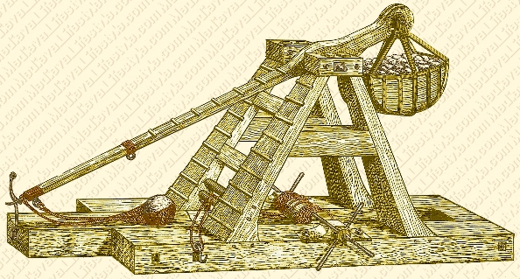
Year 5 : D&T - Mechanical Systems
Subject Specific Vocabulary
ballista | an ancient military siege engine in the form of a crossbow.
catapult | A catapult is a type of machine used as a weapon to throw rocks or other things such as hot tar, that would cause damage to something else.
hinge | A hinge is a type of joint that attaches two things together while allowing for limited movement.
lever | a rigid bar resting on a pivot, used to move a heavy or firmly fixed load with one end when pressure is applied to the other.
load | the object that requires moving
mechanism | a system of parts working together in a machine; a piece of machinery.
siege | a military blockade of a city, or fortress.
trebuchet | a kind of catapult that was used to hurl heavy stones or other projectiles during battles in the Middle Ages.
Key Skills
Use research and develop design criteria to inform design of innovative, functional and appealing products that are fit for purpose, aimed at particular individuals/groups.
Measure, mark out, join, assemble materials and components with accuracy.
Assemble, join, combine materials and components with accuracy and follow safety procedures.
Use a wide range of materials and components (paper, card, cardboard, craft sticks, elastic bands, tape).
Understand and use mechanical systems in their products (levers).
Critically evaluate a product to recognise its strengths and to identify areas for development (both their own and others’ work).
Lines of Enquiry
What was the purpose of Medieval siege machines, including the catapult, the ballista and the trebuchet?
In what ways can you reinforce and strengthen a 3d framework?
How can mechanical systems such as levers, cams, pulleys or gears create movement?
How does choosing the correct tools and using them appropriately help to develop effective techniques?
How does exploring different materials and identifying which one(s) best fit the purpose lead to a more effective outcome?
How can celebrating what has gone well and recognising what has not gone well enable us to make improvements to our work?

Slide 4
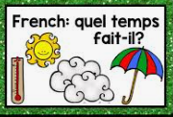
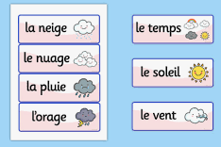
Year 5: FRENCH - Quel temps fait-it? (What’s the weather like?)
Subject Specific Vocabulary
Il pleut | It’s raining
Il neige | It’s snowing
Il y a du soleil | It’s sunny
Il y a du vent | It’s windy
Il y a un orage | It’s stormy
Il fait beau | The weather is fine
Il fait mauvais | The weather is bad
Il fait froid | It’s cold
Il fait chaud | It’s warm
Quel temps fait-il? | What’s the weather like?
Lines of Enquiry
What is the weather like?
How can I use my knowledge of the vocabulary associated with the weather to complete a listening task?
How can I use my knowledge of the vocabulary associated with the weather to describe the weather on a map (oral and written)?
How can I present my response to, ‘Quel temps fait-il?’
Key Skills
Read and recognise the vocabulary for weather.
Say and write accurately the vocabulary for weather in French.
Ask the question, ‘What is the weather like today?’ in French.
Answer the question, ‘What is the weather like today?’ in French.
Describe the weather in different regions of France, using weather maps and symbols, in spoken and written form.

Slide 5
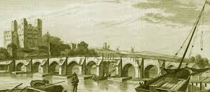
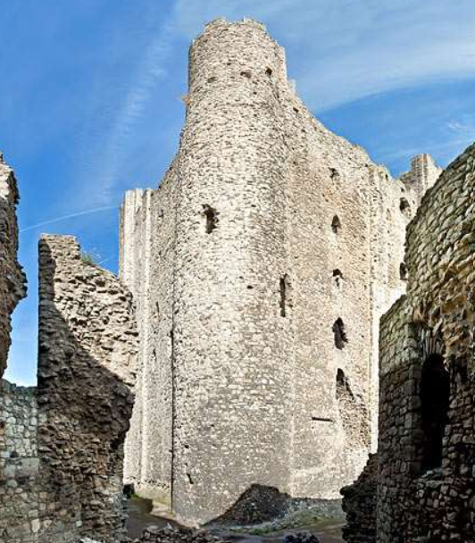
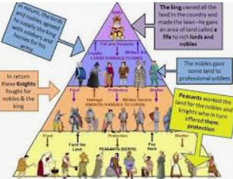
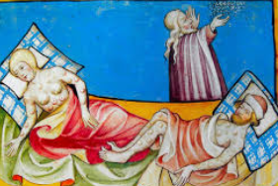
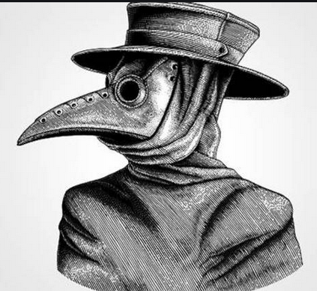
Year 5 : Medieval Medway – How would you have fared? (History)
Subject Specific Vocabulary |  | Key Skills | Lines of Enquiry
baron | A baron leased land from the king. In return, a knight had to sit on the King’s Counsel, pay rent and provide military service to the king. | Identify, locate, describe and explain the spread of the Black Death across the UK. | What was daily life like in Medieval England?
Black Death | A type of plague that was spread through the bite of infected fleas. | Identify, describe and record the sequence of symptoms associated with the Black Death. | When and where did The Black Death begin and where did it spread to? What were the symptoms of the Black Death and how was it treated?
Feudal system | Used in Medieval Times, the Feudal System, or Feudalism, is a system of land ownership and duties. | Understand the Feudal System of Medieval Europe; empathise with different groups of people within the system and make reasoned judgements about its success. | How was Medieval society in England organised and was it ‘fair’?
knight | A knight was given land by the baron in return for providing military service when demanded by the king. They also protected the baron and his family from attack.
Medieval | Medieval Times (or the Middle Ages) is a period in the history of Europe from 500 AD (the end of the Roman Empire) to 1500 AD. | Sequence events of the Peasants’ Revolt; explain the significance of Rochester to the Peasants’ Revolt and evaluate the impact of the Revolt. | Who led the Peasants’ Revolt of 1381 and what were peasants revolting against?
Peasants’ Revolt | A rebellion of peasants in England in 1381. It was the biggest rebellion of farmers in Medieval England. | Compare and contrast maps of the local area during the Middle Ages with the present-day. Reach informed conclusions about changes over time. | What is the evidence of Rochester’s Medieval past?
plague | A disease that causes death and spreads quickly to a large number of people.
rebel | A person who fights against or does not obey authority.
siege | The act of moving an army around a fortified place in order to capture it. | Apply knowledge of England in the Middle Ages to describe daily life in the local area.
symptoms | A noticeable change in the body or its functions that indicates a disease. |  | How successful was the siege of Rochester Castle?
villein/serf | Villeins, sometimes known as serfs, were given land by knights. They had to provide the knight with free labour, food and service whenever it was demanded.

Slide 6
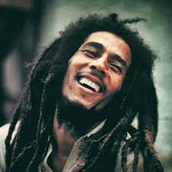
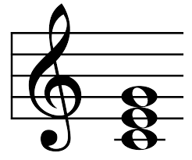
Year 5: Music – How does music teach us about our community?
Subject Specific Vocabulary
Time signature | The type and number of beats in a bar
Key signature | Where it shows what key the music is in.
Hook | A term used in pop music to describe a short catchy phrase or riff that we can’t stop singing; the bit that ‘hooks’ us in; the main musical idea from a song that we remember
Structure | How the sections (verses and choruses etc) of a song are ordered to make the whole piece.
Improvise | To make up a tune and play it on the spot.
Major | A key with a bright/happy sound
Minor | A key with a dark /sad sound
Chord | A chord in music is when two (usually three) or more notes are played together
Texture | Layers of sound in music.
Sticky Knowledge
A chord which is built up of the first, third and fifth notes of a scale is called a ‘tonic triad’. If it is made from a major scale, it is a major chord. If it is made from a minor scale, it is a minor chord. However, any combination of notes played simultaneously is considered a chord.
Reggae is a popular style of Jamaican music, which evolved out of earlier styles like Ska and Rocksteady in the 1960s. Reggae is strongly linked with the Rastafarian religion, which promotes natural healthy living and recognises that the history of Black people does not start with slavery.
The term 'Pop music' is shortened from 'Popular music' - meaning music that lots of people like to listen to. Different countries have their own versions of Pop music, like K-pop (from South Korea), Zim Pop (from Zimbabwe) and Britpop (from the UK).
John Williams (b.1932) is one of the most popular and successful Hollywood film composers of all time. His music is exciting, emotional and direct, influenced by both 19th and 20th-century composers.
Key Skills (Lesson Learning) Children will be able to:
Demonstrate an understanding and appropriate use of musical language (including musical elements), from both prior and new learning. Identify and describe feelings as they relate to music. Demonstrate an understanding of the musical style and a broader understanding of the cultural and historical connections of the music. Use appropriate musical language (with confidence) to describe and discuss the music. Create a four, six or eight-bar melody. Make an informed decision as to which notes to use when composing and improvising with the song. Explore rhythm patterns created from quavers, crotchets, semiquavers, minims and their rests. Improvise over a simple groove, responding to the beat and creating a satisfying melodic shape.
Notes:
6

Slide 7
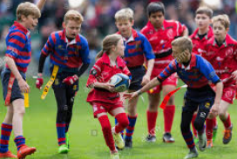
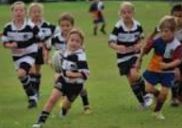
Year 5: PE – Tag Rugby
Subject Specific Vocabulary – Key words
Dodging | Direction
Spatial awareness | Speed
Eye contact | Wide hands
Hug the ball | Move your feet
Hands ready to catch | Control
Accuracy | Two handed throw and catch
Pass and run | Aim
Space | Place the ball down
Key Skills - Objectives
To learn how dodge and weave an object using speed and direction
To learn how to hold and catch a rugby ball with 2 hands
To learn to move their feet towards the ball for a successful catch and how to turn in the air away from their defenders to avoid a knock on
To learn how to use the correct techniques to throw the rugby ball backwards down a line and whilst moving
To learn to tag a player and understand the rules for tagging
To learn how to pass and move towards a goal area – combining passing and running skills using and developing tactics.
To learn how to score in rugby by placing the ball down in target areas.
To learn how to work as a team communicating ideas and rules
Rules of the game
Tag Rugby is a non-tackle minimal contact version of Rugby. The game is played in two teams, usually 5-7 players per team.
Only the ball carrier can be tagged. A tag is simply the removal by a defender of one of the two ribbons.
Once tagged the player in possession must stop and pass the ball to a team-mate within three seconds.
A try is scored by the attacking team when they place the ball on ground on or over the try line.
The team with the most tries at the end of the game wins.
Team Work / Fair Play
Respect coaches, teammates, opposition and referees.
To accept the decision of the referee with good grace.
Players work towards a collective effort to score points to achieve success.
Listen and take on board the ideas of others.
Local Clubs
Medway Rugby Football Club
Lordswood Rugby Football Club
Medway Dragons Rugby League Football Club
Famous People/Teams
Owen Farrell
Jonny Wilkinson
Sir Clive Woodward
England National Rugby Union Team

Slide 8
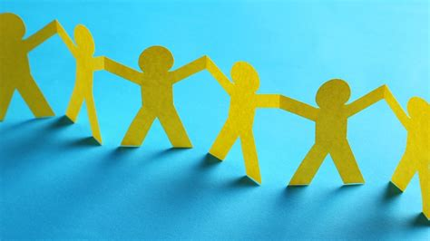
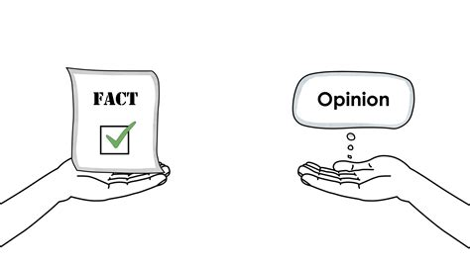
Year 5 : PSHE – Rights and Responsibilities
Subject Specific Vocabulary
fact | A thing that is known or proved to be true
opinion | A view or judgement formed about something, not necessarily based on fact or knowledge.
right | Something people should be allowed to have or are entitled to.
responsibility | Having the duty to looking after something.
duty | What we should or must do in order to look after something.
community | A group of people living in the same place or having a particular characteristic in common.
voluntary | Done, given, or acting of one's own free will.
pressure group | A group that tries to influence public policy in the interest of a particular cause.
cooperation | The action or process of working together to the same end.
conflict | A disagreement or argument, typically a prolonged one.
consequence | A result or effect, typically one that is unwelcome or unpleasant.
assertive | Having or showing a confident and forceful personality.
Key Skills
Give a range of examples of our emotional needs and explain why they are important.
Give a few examples of how to stand up for myself (be assertive) and say when I might need to use assertiveness skills.
Give examples of some of the rights and related responsibilities I have as I grow older, at home and school. I can also give real examples of each that relate to me.
I can give a few different examples of things that I am responsible for to keep myself healthy.
I can explain that local councils have to make decisions about how money is spent on things we need in the community. I can also give an examples of some of the things they have to allocate money for.
I can give an example of how this spending might be popular or unpopular with different people in the community.
I can explain some of the wider rights and responsibilities that we have, such as to the community or the environment.
Lines of Enquiry
What are examples of health and wellbeing issues in the media and what can we do?
What is the difference between a fact and an opinion?
What is biased reporting?
What do we mean by the terms voluntary, community and pressure (action) group?
What are the differences between responsibilities, rights and duties?
What are the costs involved in producing and selling an item?
What do we mean by the terms loan, credit, debt and interest?
What responsibilities do local councilors have and how are they chosen?

Slide 9
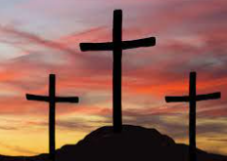
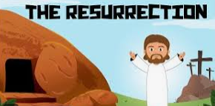
Year 5 : RE (Christianity) - How significant is it for Christians to believe God intended Jesus to die?
Subject Specific Vocabulary – Key words
crucifixion | being put to death by being nailed to a cross.
disciples | Special friends of Jesus.
incarnation | God as a man.
pharisee | A strictly orthodox Jew, who adheres closely to the rules and scriptures.
Pilate | The Roman governor of the region.
resurrection | Coming back to life after being put to death.
salvation | Christians believe that salvation is the gift of freedom from our sins that Jesus made possible by taking the punishment for our sins on the cross.
Key Skills - Objectives
Explain why Christians believe God put Jesus on Earth.
Explain the Christian concept of salvation.
Consider what sacrifices I would be prepared to make to achieve something I felt was right or necessary.
Consider what I would be prepared to make a sacrifice for.
Identify evidence in the Bible that Jesus foretold his own death.
Lines of Enquiry
For what reason do Christians believe God put Jesus on Earth?
What is the Christian concept of salvation?
What sacrifices would I be prepared to make for something I felt was right or necessary?
Can I think of anything that I would wish to make a sacrifice for?
What evidence is there in the Bible that Jesus knew he was going to his death?

Slide 10
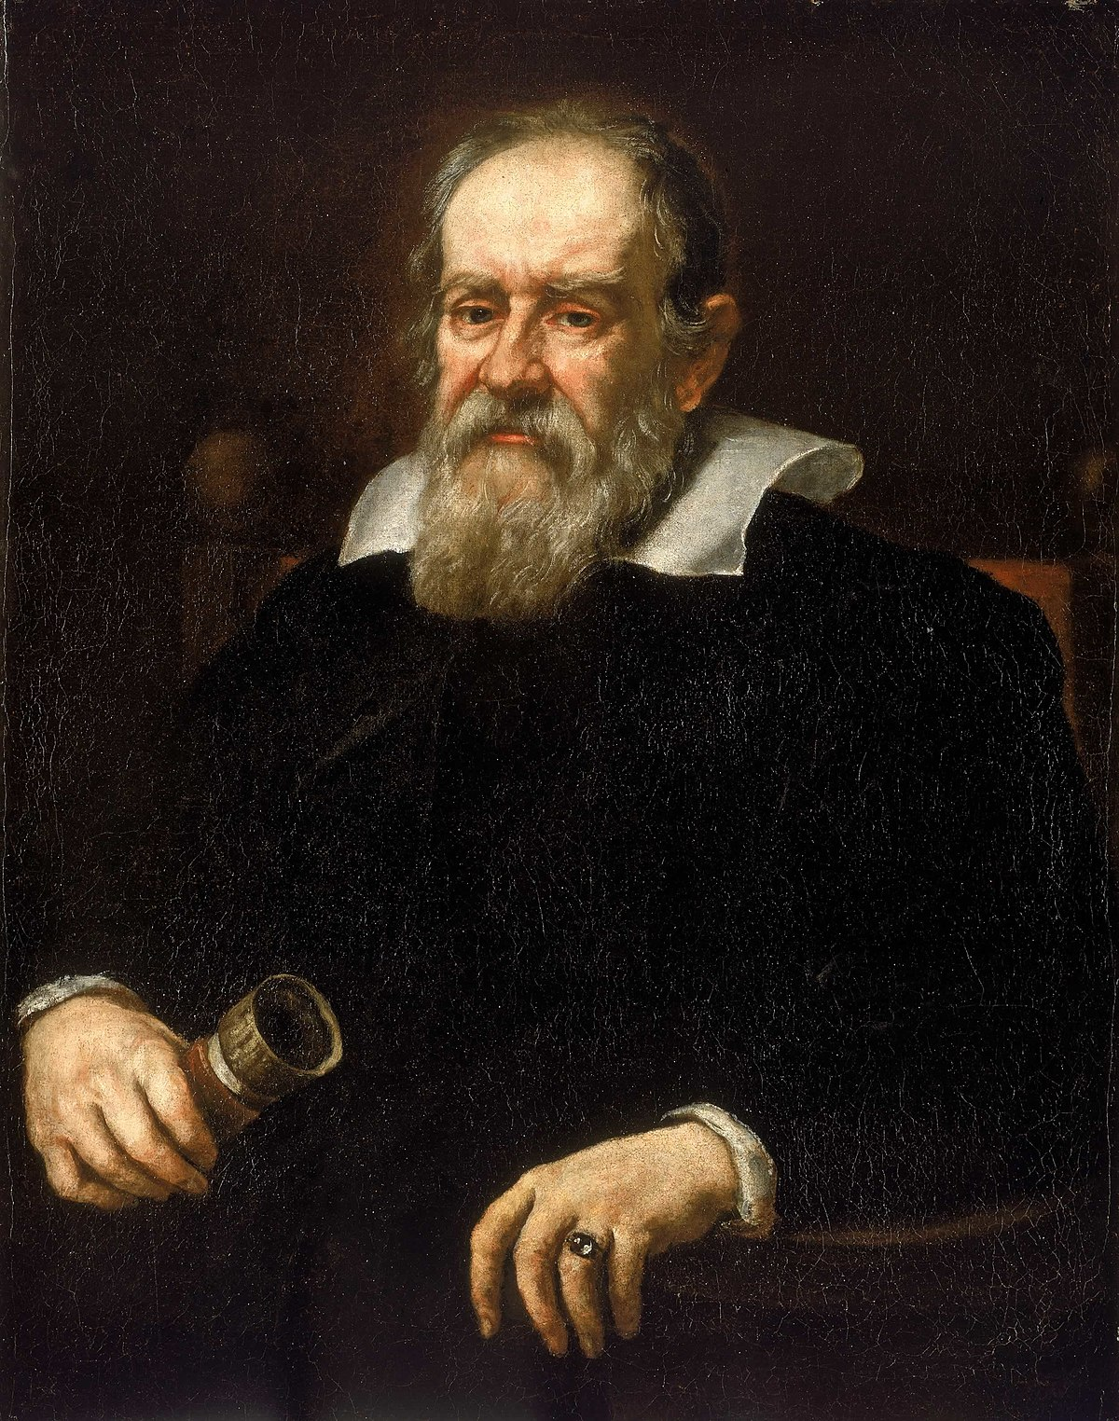
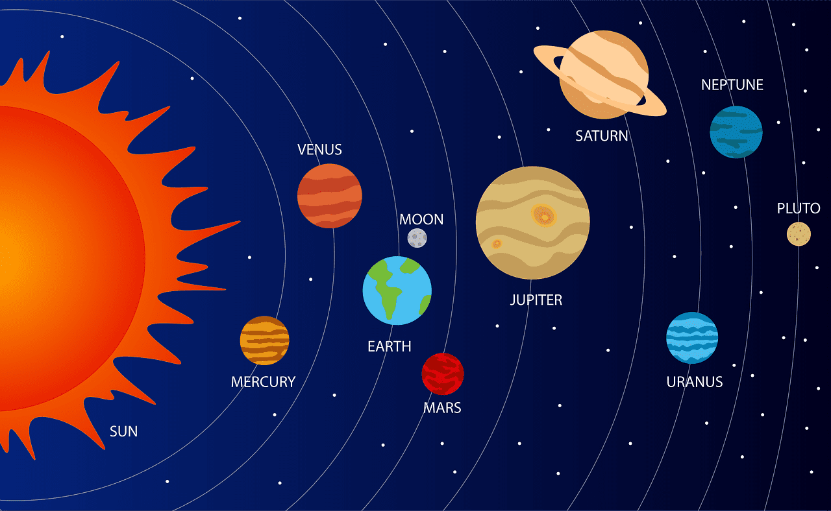
Year 5: Earth and Space Knowledge Mat
Subject Specific Vocabulary |  | Working Scientifically | Lines of Enquiry
Orbit | An orbit is a repeating path that one celestial body takes around another. | Report and present findings from enquiries, including conclusions, causal relationships and explanations of and degree of trust in results, in oral and written forms. | How do the planets move in our solar system?
Solar system | The solar system is made up of 8 planets that orbit our sun. It also consists of asteroids, moons, comets and stars. | Identify scientific evidence that has been used to support or refute ideas or arguments. | Who were Copernicus and Galileo and what impact did they have on our understanding of space?
Astronomical | Astronomy is the study of outer space, focussing on celestial bodies such as stars, comets, planets and galaxies. | Take measurements, using a range of scientific equipment, with increasing accuracy and precision taking repeat readings when appropriate. | How does the Earth’s movement affect day and night?
Planet | There are 8 planets in our solar system: Mercury, Venus, Earth, Mars, Jupiter, Saturn, Uranus and Neptune. | Plan different types of scientific enquiries to answer questions, including recognising and controlling variables where necessary. | How does the moon move in relation to the Earth?
Rotation | This is when a shape is turned around a fixed point. | Record data and results of increasing complexity using scientific diagrams and labels, classification keys, tables, scatter graphs, bar and line graphs. | How were the craters of the moon formed?
Crescent moon | It is a sliver of the moon that is lit up and can be seen. It is less than half of the moon. | Use test results to make predictions to set up further comparative and fair tests. | What are the different planets in our solar system and what do we know about them?
Gibbous moon | It is when three quarters of the moon are lit up and visible.
Eclipse | An eclipse occurs when an astronomical object is temporarily obscured. A lunar eclipse is when the moon moves into the Earth’s shadow, blocking the suns rays from striking the moon
Lunar | Anything related to the moon.

