Slide 1
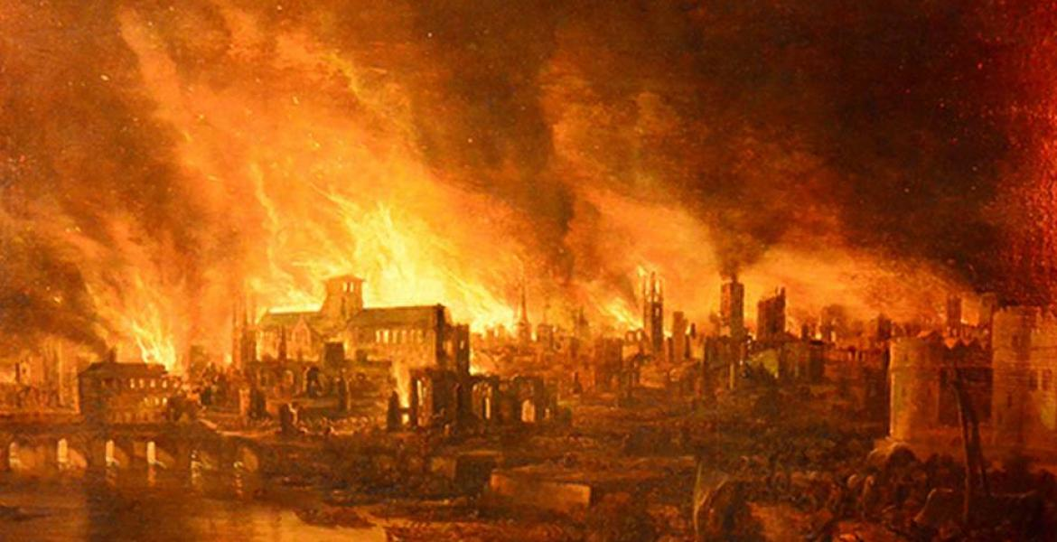
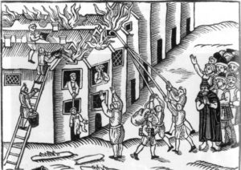
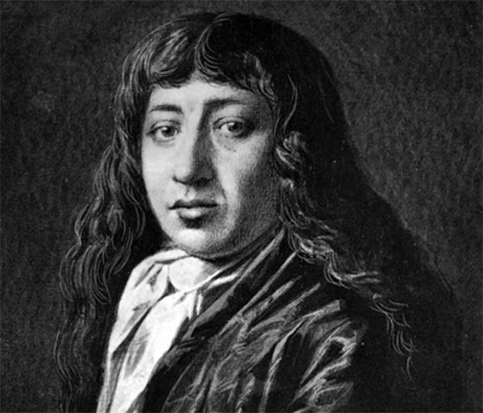
History – The Great Fire of London – What was London like in 1666?
Subject Specific Vocabulary |  |  | By the end of the unit, I will be able to answer these questions.
Timeline | A way of showing objects or events in the order that they happened. |  | How did the Great Fire of London change how we live today? How did the fire start? What sources can we use to find out about the past? Why/how did the fire spread so quickly? How was life in the 17th century different to now? Who was Samuel Pepys and why is he such an important historical figure?
Eye witness | A person who has seen something happen and can give a first-hand description of it
Diary | A book in which one keeps a daily record of events and experiences. | Key Skills
Source | A place, person, or thing from which something originates or can be obtained. | I can find out some of the ways in which London has changed.
Historical figure | A person who lived in the past who is famous for doing something special/important. | I can find out some of the ways in which how we live now is different and similar to how people lived in 1666.
 |  | I can find out about how the Great Fire started and spread across London.
 |  | I can role play and re-enact scenes from the Great Fire of London.
 |  | I can sequence the events of the Great Fire of London
 |  | I can recreate a scene from the Great Fire of London

Slide 2
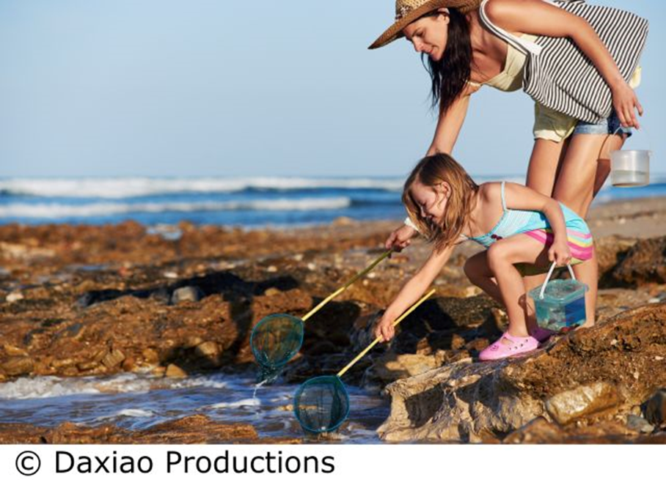
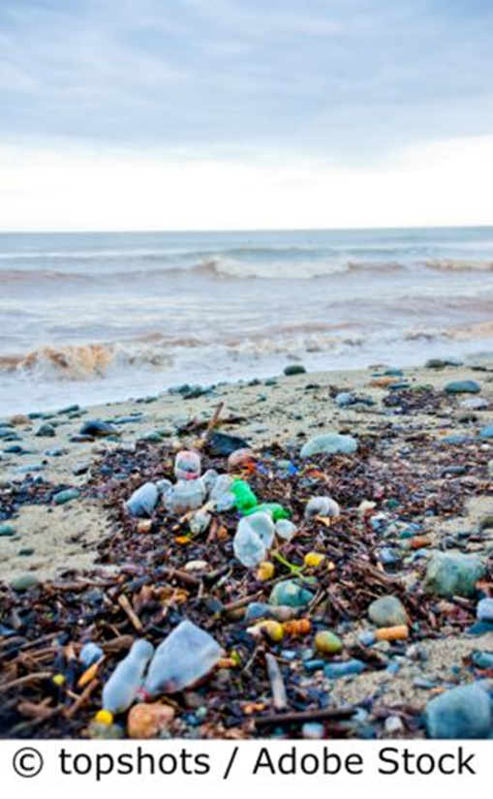
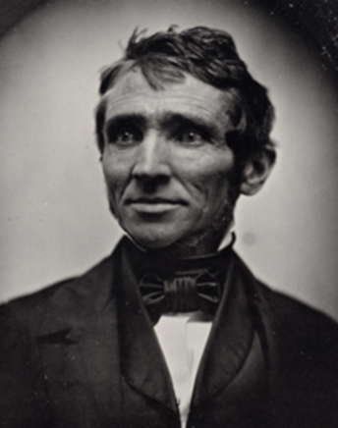
Year 1: Science- Holiday
Subject Specific Vocabulary |  | Working Scientifically | By the end of this unit, I will be able to answer these questions:
Habitat | The place where an animal lives. | Ask simple questions and recognise that they can be answered in different ways. Observe closely, using simple equipment. Perform simple tests. Identify and classify. Use observations and ideas to suggest answers to questions. Gather and record data to help in answering questions.
 |  |  | What animals live in the sea? What animals are carnivores, herbivores or omnivores? What is a food chain? Can you describe what different animals look like? Why is pollution bad for sea animals? Can you name different materials? Can you name the properties of materials? How can you protect yourself from the sun? How can you group materials based on their properties?
Marine biologist | A person who finds out about things that live in the sea
Pollution | Rubbish left in the environment by humans
Sunburn | When your skin gets damaged by the sun and goes red.
Food chain | Shows how plants and animals rely on each other for food. | Famous Scientist: Charles Goodyear

Slide 3
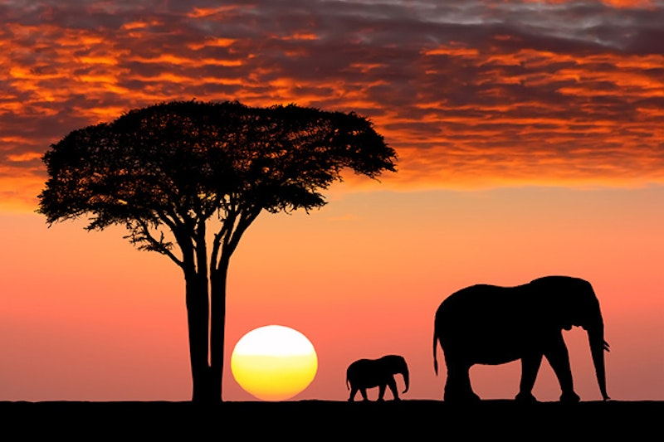
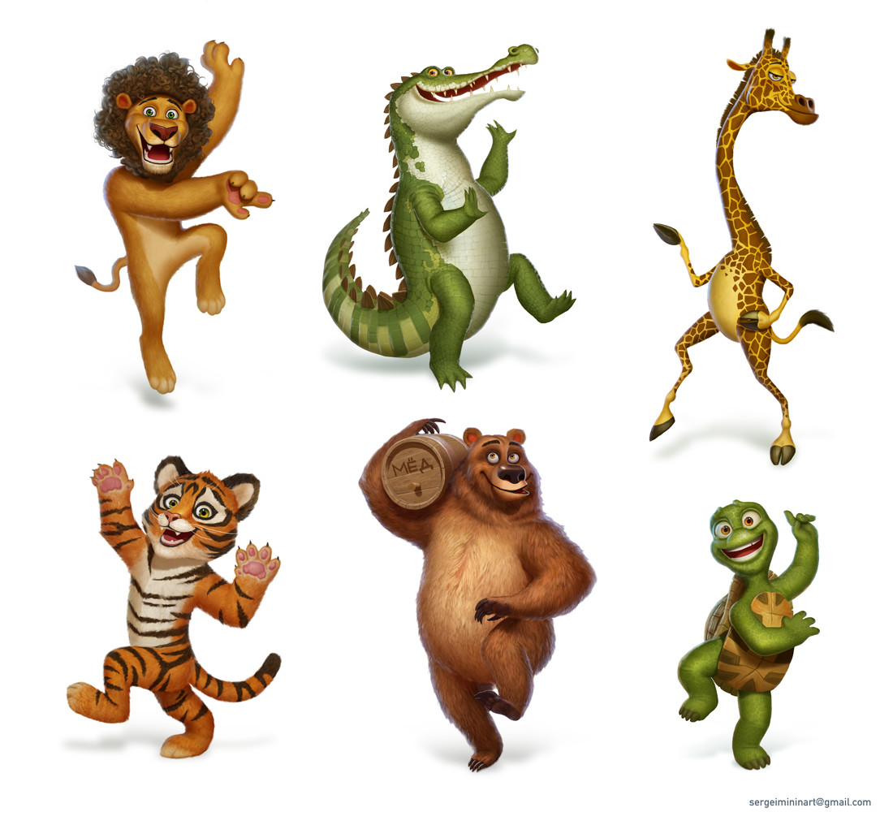
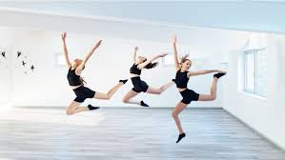
Year 1: PE- Dance Get Set 4 PE – On Safari
Key Skills- Objectives
To work safely around others.
Emotional: To be confident to share ideas.
Thinking: To remember and repeat actions.
Using counts of 8 to stay in time with music.
Social: To share ideas with others and work together to decide on the best approach.
Emotional: To attempt challenges outside of my comfort zone.
Thinking: To feedback on another group’s performance and suggest areas for improvement
Subject Specific Vocabulary- Key Words
Travel | To move from one space to another.
Perform | To show an audience an action or task.
Choreographer | A person who makes up a dance.
Rehearse | To keep practising an action or task so that you can get better.
Team Work/ Fair Play
Observing and give feedback
Always supporting each other
Trust and respect each other
Famous People
Choreographer, Christopher Wheeldon's ballet, Carnival of the Animals, features a cast of nearly 50 dancers and tells the story of a young boy, Oliver Pendleton Percy the Third, who falls asleep in New York's American Museum of Natural History, and dreams that the people in his life — family members, teachers, classmates — have all been transformed into animals.

Slide 4
Year 1 RE: Judaism – Are Rosh Hashanah and Yom Kippur important to Jewish children?
Subject Specific Vocabulary |  | By the end of this unit, I will be able to answer these questions: | Key Skills
Jew | A person whose religion is Judaism | What does forgiveness mean? | We are learning to empathise with Jewish children by understanding what Rosh Hashanah and Yom Kippur mean to them.
Judaism | The religion of Jewish people | What is Rosh Hashannah?
Forgiveness | No longer feeling angry at another person, or at yourself. | What is Yom Kippur?
Rosh Hashannah | The start of the religious new year for followers of Judaism | Are Rosh Hashanah and Yom Kippur important to Jewish children?
Yom Kippur | The day when we try to make up for any wrong things we have done.
Religion | Religion is belief in a god or gods and the activities that are connected with this belief, such as praying or worshipping in a building such as a church or temple

Slide 5
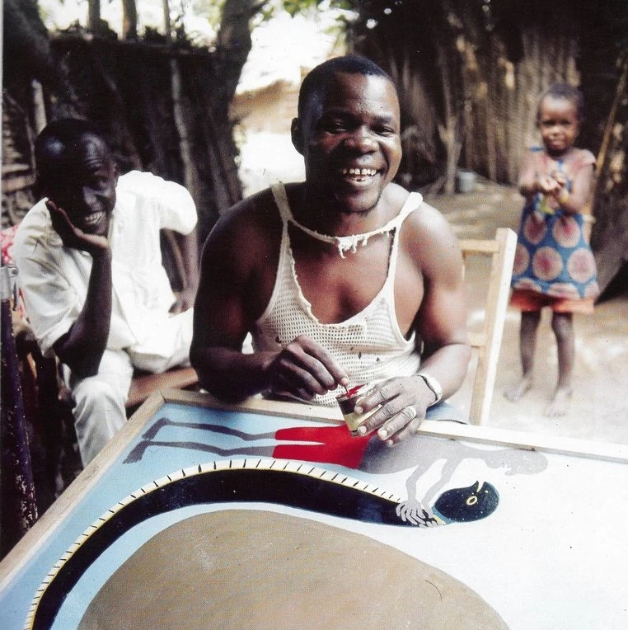
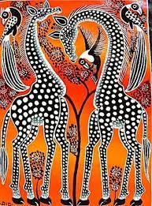
Art – Carnival of the Animals KS1 Knowledge Mat
Subject Specific Vocabulary |  |  | By the end of this unit, I will be able to answer these questions:
Edward Tingatinga | Edward Tingatinga began the art movement in 1968 but died 4 years later. His style of work is now copied across Eastern Africa. |  | Who was Edward Tingtinga and where was he from? How did Edward Tingatinga use colours, shapes, patterns and African animals to create his art? How can you create different paint techniques? What are primary colours and how can they make secondary colours?
Culture | Many different things make up a society's culture. These things include food, language, clothing, tools, music, arts, customs, beliefs, and religion.
Africa | One of the hottest, driest continents in the world. | Key Skills To explore the work of artists, craftspeople and designers from different times and cultures for differences and similarities
Patterns | A design that included repeated shapes. | To start to mix a range of secondary colours, moving towards predicting resulting colours.
Paint techniques | Different ways of applying paint to paper or different materials. | To use a variety of tools and techniques including different brush sizes and types
Media | The different tools and materials used by an artist. | To name the primary and secondary colours.
Prime colours | Red, yellow and blue – they can be used to make new colours. | To be an Independent Artist he/she can help prepare and clear away his/her work area.
Secondary colours | Orange, green and violet - colours made by mixing the primary colours. | To begin to control the types of marks made with the range of media.
Tools | Pencils, paint brushes, cotton buds – objects that can be used to create a piece of art. | To review what they and others have done and say what they think and feel about it.

Slide 6
Year 1 :Programming B – Introduction to animation
Subject Specific Vocabulary |  | Software and Tools | By the end of this unit, I will be able to answer these questions:
Programming | writing a group of instructions for a computer to process/execute | Laptop with mouse Scratch Jr E-Safety Online Relationships I can give examples of when I should ask permission to do something online and explain why this is important. I can use the internet with adult support to communicate with people I know I can explain why it is important to be considerate and kind to people online and to respect their choices. Managing Online Information I can give simple examples of how to find information using digital technologies I know / understand that we can encounter a range of things online including things we like and don’t like as well as things which are real or make believe / a joke. I know how to get help from a trusted adult if we see content that makes us feel sad, uncomfortable, worried or frightened. | How can I move a character on a screen?
Algorithm | a set of step-by-step instructions that describe how to perform a task
 |  |  | Can a series of commands be joined together to move a character?
Sprite | images children can create and program in the Scratch interface |  | Can I add and delete characters?
 |  |  | How can I get help if I see something online that makes me feel uncomfortable?
Coding | the process of writing instructions for a computer to follow |  | How can a mouse be used?
 |  |  | Why is it important to be considerate and kind to people online?
Unit Overview: Learners will be introduced to on-screen programming through ScratchJr. Learners will explore the way a project looks by investigating sprites and backgrounds. They will use programming blocks to use, modify, and create programs. Learners will also be introduced to the early stages of program design through the introduction of algorithms.
Unit Overview: Learners will be introduced to on-screen programming through ScratchJr. Learners will explore the way a project looks by investigating sprites and backgrounds. They will use programming blocks to use, modify, and create programs. Learners will also be introduced to the early stages of program design through the introduction of algorithms.

Slide 7
Year 1: PSHE Knowledge Mat Growing and Changing
Subject Specific Vocabulary |  |  | By the end of this unit, I will be able to answer these questions:
Adult | a person who is fully grown or developed. |  | Getting Help What is a trusted adult? Which adults at home can I ask for help? Which adults at school can I ask for help?
Trusted | Someone who is there and believes in you
Growing | to become larger by natural development | Key objectives: I can identify an adult I can talk to at both home and school if I need help I can tell you some things I can do now that I couldn’t do when I was a toddler. I can tell you what some of my body parts do. | Becoming Independent What can I do now, that I couldn’t do as a baby? What can I do now, that I couldn’t do as a toddler? What can I do now, that I couldn’t do last year in Reception? What am I still learning to do?
Heart | the organ that pumps blood through the body of a person or animal.
Lungs | two organs in the chest that are used in breathing
 |  |  | Body Parts Which body parts are on the inside? Which body parts are on the outside? How do different body parts work? Are girls’ and boys’ bodies the same? Which parts are different?
Penis | The male organ
Vulva | The female organ

Slide 8
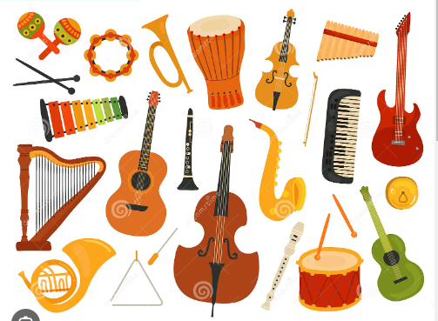
Music: How Does Music Connect Us With The Environment? Explore Sound and Create a Story
Subject specific vocabulary
Tempo | the speed at which a musical piece is to be played.
Pitch | How high or low a note sounds
Beat | The beat is the steady pulse that you feel in the tune, like a clock's tick
Instrument | An instrument is usually a tool for making music,
Duration | How long a sound lasts
Posture | How to stand while singing
Key Objectives
● Demonstrate an awareness of pulse/beat when listening, moving to and performing music. ● Demonstrate an understanding and use of basic differences in pitch (high and low) and note duration (long and short). ● Demonstrate a basic understanding of the importance of posture and technique when performing. ● Demonstrate an understanding of the basic concepts of improvisation and composition. ● Introduce the performance (any connection to the Social Theme is an added bonus).
By the end of this unit, I will be able to answer these questions:
How does this music make you feel? Why do you like/dislike this piece of music? What instruments can you hear in this piece of music? Can you keep the beat to this piece of music? Is the tempo fast or slow?

Slide 9
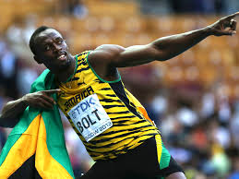
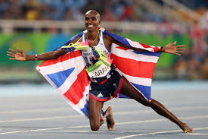
Year 1: PE - Athletics
Subject Specific Vocabulary – Key words
Obstacles | An object that blocks your way.
Technique | A skilful way of doing or achieving something.
Performance | How well you carry out an action or sport.
High jump | Jumping, without help, over a bar.
Distance | How far someone or something has travelled.
Javelin | A spear like piece of equipment that is thrown.
Shotput | A sport involving pushing a heavy ball as far as possible.
Long jump | A sport that requires you to jump as far as possible in one leap.
Athletics | Sports including running, jumping, throwing
Key Skills - Objectives
Running To run over different distances and obstacles To run as a team. To understand how technique can affect performance.
Jumping To apply the take-off position. To know how to land. To know how some jumps are better for height and others for distance, how they can join some jumps together. To know how jumping can be improved, through the development of technique
Throwing To know a range of throwing actions-fling, pull, push. To be able to use a variety of softer, lighter, smaller equipment. To recognise how accuracy and distance can be increased through the development of throwing technique.
Team Work / Fair Play
Fair Play is an essential value in all sport.
Fair Play includes: Good sportsmanship, honesty and respect whether you win or lose.
Famous People/Teams
Usain Bolt
Mo Farah
Chris Hoy
Dame Kelly Holmes
Local Clubs
Medway and Maidstone AC

