Slide 1
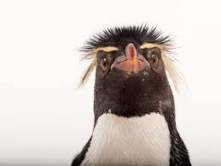
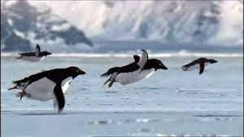
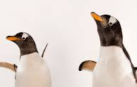
Year 1: Geography- Why don’t penguins need to fly?
Subject Specific Vocabulary |  |  | By the end of this unit, I will be able to answer these questions:
 |  |  | Where is Pip’s home and what do we find there? How are penguins able to survive in Antarctica? How does Antarctica compare with the Sahara Desert? How is the Arctic different from the Antarctic? Why are there no Polar Bears in Antarctica? Why do Marco and Polo find visiting each other so difficult? So why don’t penguins need to fly?
Compare | The similarity or differences between things.
Characteristics | A feature or quality belonging typically to a person, place, or thing and serving to identify them.
Landscape | All the visible features of an area of land.
Weather conditions | Temperature and wind and clouds and precipitation.
Continent | Any of the world's main expanses of land. | Key objectives:
Blizzard | A severe snowstorm with high winds. | Identify, recognise and describe the key geographical features of the Antarctic environment Identify ways in which penguins are adapted to the Antarctic environment Identify countries in Africa which lie within the Sahara Desert Identify, recognise and describe the key geographical features of the Sahara Desert Explain why Antarctica is a desert despite being the coldest place on Earth Describe ways that the Arctic region and North Pole is similar to and different from (compare and contrast) Antarctica and the South Pole and offer reasons for such differences Describe and explain the components of the food chain of an Emperor Penguin
Habitat | The natural home or environment of an animal, plant, or other organism.
Adapted | Make (something) suitable for a new use or purpose; modify.

Slide 2
Geography Term 4 Sticky Knowledge
I know that some penguins live in Antarctica.
I know that Antarctica is very cold and often windy. Most of the land is covered in thick ice.
Antarctica is a desert as it gets very little rain or snowfall.
I know that penguins are able to survive in Antarctica due to their thick, waxy feathers and blubber under the skin.
I know that Antarctica is extremely cold and the Sahara Desert is extremely hot.
Penguins don’t need to fly as all they need is on land or in the ocean. Their wings are evolved for swimming rather than flying.

Slide 3
Music: Combining pulse, pitch and rhythm
Subject specific vocabulary
Pulse | the regular heartbeat of the music, the steady beat
Pitch | How long or high the sound is.
Rhythm | long and short sounds or patterns that happen over the pulse, the steady beat
Performing | Present a form of entertainment to an audience.
Improvise | create and perform (music, drama, or verse) spontaneously or without preparation.
Compose | write or create (a work of art, especially music or poetry).
Key Objectives
Demonstrate an awareness of pulse/beat when listening, moving to and performing music. Demonstrate an understanding and use of basic differences in pitch (high and low) and note duration (long and short). Demonstrate a basic understanding of the importance of posture and technique when performing. Demonstrate an understanding of the basic concepts of improvisation and composition. Introduce the performance
By the end of this unit, I will be able to answer these questions:
What is a pulse/beat? What is pitch? What is improvisation? What is composition?

Slide 4
Music Term 4 Sticky Knowledge
I know that a pulse is the regular heartbeat of the music, the steady beat
I know that pitch is how long or high the sound is.
I know that rhythm is the long and short sounds or patterns that happen over the pulse: the steady beat.
I know that to improvise is to create and perform (music, drama, or verse) spontaneously or without preparation.
I know that to compose means to write or create (a work of art, especially music or poetry).

Slide 5
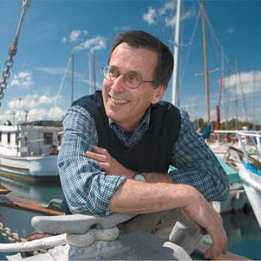
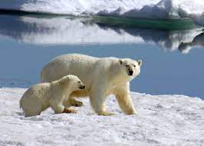
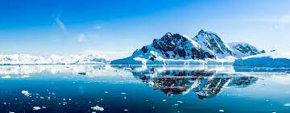
Year 1: Science- Polar places
Subject Specific Vocabulary |  | Working Scientifically | By the end of this unit, I will be able to answer these questions:
Arctic | The Arctic is the area around the northernmost part of the Earth. | Ask simple questions and recognise that they can be answered in different ways. Perform simple tests. Identify and classify. Use their observations and ideas to suggest answers to questions.
 |  |  | What do we need for a polar adventure? How will we get there? What to wear? Which material? Which gloves would be best to wear? Am I a herbivore, carnivore or omnivore?
Antarctica | The Antarctic is the area around the southernmost part of the Earth.
Carnivore | An animal that eats mostly meat, e.g. spiders, frogs, owls, polar bears, seals, whales and wolves.
Flexible | A material that bends easily without breaking.
Habitat | The place where you will normally find an animal or plant living. | Famous Scientist: Eddy Carmack
Herbivore | An animal that eats only plants, e.g. butterflies, snails, caribou, cows, deer, elephants, guinea pigs, horses, pandas, reindeer.
Omnivore | An animal that eats both meat and plants, e.g. wasps, magpies, bears, dolphins, hedgehogs, humans.
Waterproof | Does not let water through.

Slide 6
Science Term 4 Sticky Knowledge
I know that the Arctic is the area around the northernmost part of the Earth.
I know that the Antarctic is the area around the southernmost part of the Earth.
I know that the polar regions are extremely cold and people who go there need to wear warm, waterproof clothes.
I know that materials have different properties and are suited to different roles.
I know that a herbivore eats plants, a carnivore eats meat and an omnivore eats both plants and meat.

Slide 7
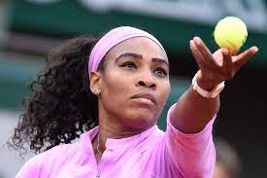
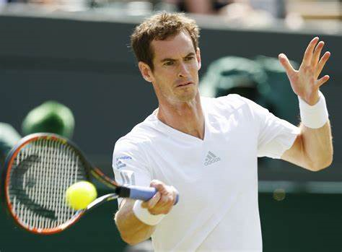
Year 1: PE- Tennis
Subject Specific Vocabulary- Key Words
Tennis | Tennis is a game played by two or four players on a rectangular court. The players use an oval racket with strings across it to hit a ball over a net across the middle of the court.
Forehand | a shot in tennis or squash in which the palm of your hand faces the direction in which you are hitting the ball
Volley | to hit the ball before it touches the ground.
Serve | you throw the ball up and hit it to start play.
Underarm | Underhand serve is a type of serve delivered by hitting the ball below shoulder level.
Key Skills- Objectives
I can practice rolling and throwing the ball underarm gradually linking that technique to the forehand shot.
I can develop the forehand shot in tennis linking similarities between throwing a ball and playing the forehand shot.
I understand what a volley shot is and when this shot can be used in tennis.
I can start a game using a underarm serve. I can demonstrate my tennis skills that I have learnt.
Team Work/ Fair Play
Fair Play is an essential value in tennis.
Fair Play includes: Good sportsmanship, honesty and respect whether you win or lose.
Local Clubs
Avenue Tennis Club
Famous People
Novac Djokovic
Andy Murray
Serena Williams
Emma Raducanu

Slide 8
PE Term 4 Sticky Knowledge
I can practice rolling and throwing the ball underarm gradually linking that technique to the forehand shot.
I can develop the forehand shot in tennis linking similarities between throwing a ball and playing the forehand shot.
I understand what a volley shot is and when this shot can be used in tennis.
I can start a game using a underarm serve.

Slide 9
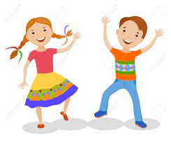
Year 1: PE- Dance
Key Skills- Objectives
I can use counts of 8 to move in time and make my dance look interesting. I can explore pathways in my dance. I can create my own dance using actions, pathways and counts. I can explore speeds and actions. I can copy, remember and repeat actions that represent the theme. I can copy, repeat, create and perform actions that represent the theme.
Team Work/ Fair Play
Fair Play is an essential value in dance.
Fair Play includes: co-operation, communication, coming to decisions with a partner, respect
Subject Specific Vocabulary- Key Words
Beat | The basic rhythmic unit of a measure.
Direction | A course along which someone or something moves.
Counts | Counts of 8 helps us to stay in time with the music and we can mix up how we move within those counts to make our dance look interesting.
Commands | Give an order
Pathway | The path a dancer takes whilst moving
Choreography | Need to copy, remember and repeat actions.
Famous People
Oti Mabuse
Jordan Banjo
Darcey Bussell
AJ Pritchard

Slide 10
Dance Term 4 Sticky Knowledge
I can use counts of 8 to move in time and make my dance look interesting.
I can explore pathways in my dance.
I can create my own dance using actions, pathways and counts.
I can explore speeds and actions.
I can copy, remember and repeat actions that represent the theme.
I can copy, repeat, create and perform actions that represent the theme.

Slide 11
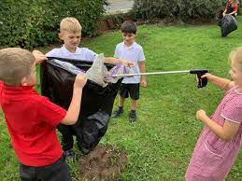
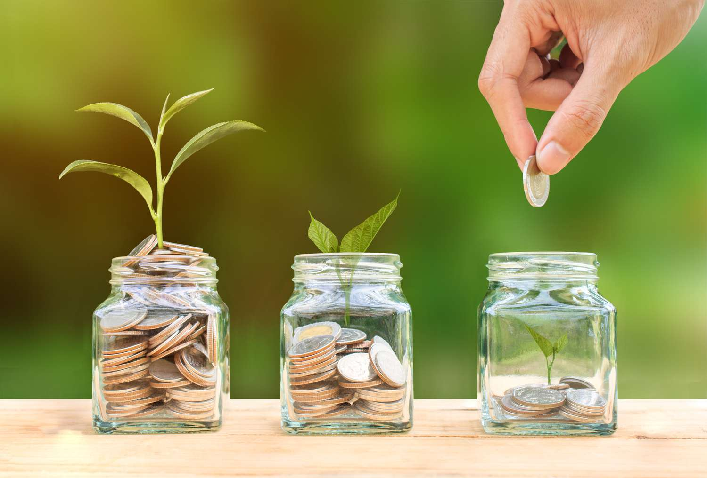
Year 1: PSHE Knowledge Mat Rights and Responsibilities
Subject Specific Vocabulary |  |  | By the end of this unit, I will be able to answer these questions:
Risk | a chance of getting hurt or losing something |  | What needs to be looked after? What do you look after? Is there anything else you can look after? Why does the environment need to be looked after? Do we need to look after money? Why? How can you look after yourself? How do you feel when you have looked after someone or something?
Environment | all the things together that surround animals and humans in the natural world,
Responsibility | Something for which a person is responsible; duty | Key objectives:
Danger | a chance of getting hurt or losing something | I can give some examples of how I look after myself - at school or at home. I can give examples of how I look after my environment – at school or at home I can also say some ways that we look after money.
Safe | providing protection from harm, loss, or danger
Safe | providing protection from harm, loss, or danger
Help | to aid or assist
Money | Money is the coins or bank notes that you use to buy things, or the sum that you have in a bank account.

Slide 12
PSHE Term 4 Sticky Knowledge
I know that I need to be “looked after” and I know who is responsible for doing this.
I know what I look after and how I do this.
I know the environment is all the things together that surround animals and humans in the natural world
I know what money is and how it is used in our society.
I know how I can keep myself safe and how to look after myself.

Slide 13
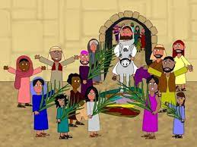
Year 1: RE Knowledge Mat Palm Sunday
Subject Specific Vocabulary |  |  | By the end of this unit, I will be able to answer these questions:
Religion | The belief and worship of a God or Gods. |  | Why was Jesus welcomed like a king or celebrity by the crowds on Palm Sunday?
Christianity | Christians are people who believe that Jesus Christ is the Son of God, and who follow his teachings and those of the Christian churches.
 |  |  | Jesus arrived as a king, but did he leave as one?
Easter | A Christian festival to celebrate Jesus coming back from the dead.
Disciples | Jesus’ special friends and followers. | Key objectives: | Did Jesus he look/behave like a king? Did Jesus want to be welcomed in this way?
Resurrection | To come back from the dead. | I can discuss how I might treat a special person and say why. I can recall what happened on Palm Sunday and can say what some of the symbols in the Easter story mean. I can recognise that Jesus must be special to Christians to be welcomed in this way and start to explain their beliefs about Him
Crucified | To be nailed to a cross.
Palm Sunday | The Sunday before Easter when we remember how people welcomed Jesús into Jerusalem by waving palm leaves,
Good Friday | A Christian holiday to remember the crucifixion of Jesus.
Easter Sunday | The day of Jesus’ resurrection.

Slide 14
RE Term 4 Sticky Knowledge
Easter is a Christian festival to celebrate Jesus coming back from the dead.
Palm Sunday is the Sunday before Easter when we remember how people welcomed Jesús into Jerusalem by waving palm leaves.
Jesus arrived as a king, but did he did not leave as one.
Good Friday is a Christian holiday to remember the crucifixion of Jesus.
Easter Sunday is the day of Jesus’ resurrection.

Slide 15
Year 1: ICT Knowledge Mat Grouping Data
Subject Specific Vocabulary |  | Software | By the end of this unit, I will be able to answer these questions:
Data | The word used to describe information. This could be facts, observations, numbers, graphs or measurements |  | How can I group these objects? What label will I give these objects? Can these objects go into more than one group? What are the properties of this object? How can I record the number of objects in each group?
Group | A collection of people, things, or ideas that are in one place or are related by characteristics
 |  | Key objectives:
Collect | To bring together into one place | I can choose how to group objects I can describe groups of objects I can record how many objects are in a group I can decide how to group objects to answer a question I can compare groups of objects I can record and share what I have found I understand that work created by others does not belong to me even if I save a copy I understand the benefits of naming my electronic work. I can demonstrate ways of naming files to help me find them later.
Similar | Having resemblance or likeness
Labels | A slip that is attached to something to identify or describe it.
 |  |  | E – safety: Online Bullying I can describe how to behave online in ways that do not upset others and can give examples. I can recognise that certain behaviours online can upset others. I can give examples of behaviours that are unlikely to upset others. I can give examples of behaviours that can make others feel more pleasant emotions (e.g. happy, satisfied, proud, etc.)
Describe | to tell someone the appearance, sound, smell, events, etc., of (something or someone) : to say what something or someone is like.

Slide 16
ICT Term 4 Sticky Knowledge
I know how to group objects
I know how to record how many objects are in a group
I can decide how to group objects to answer a question
I can compare groups of objects
I can record and share what I have found
I understand that work created by others does not belong to me even if I save a copy
I understand the benefits of naming my electronic work.
I can demonstrate ways of naming files to help me find them later.

Slide 17
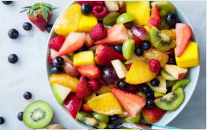
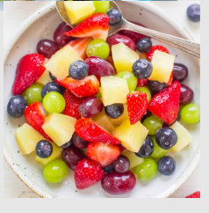
Year 1: D.T Knowledge Mat Where does food come from? Making a Healthy Fruit Kebab
Subject Specific Vocabulary |  |  | By the end of this unit, I will be able to answer these questions:
Exotic | Something that comes from a country that is far away. |  | What foods are healthy? What makes food healthy?
Healthy | Good for your health.
Unhealthy | Bad for your health. |  | Why should we eat a healthy, balanced diet?
Fruit | The sweet and fleshy product of a tree or other plant that contains seed and can be eaten as food. | Key objectives: | Where do fruits and vegetables come from?
Salad | A cold dish of various mixtures of raw or cooked vegetables. | I can use my own ideas to make something. I can make a simple plan before making. I can use appropriate resources and tools. I can cut food safely. I understand where food comes from. I understand about having a healthy and varied diet.
Diet | The kinds of food that a person, animal, or community normally eats
Plan | An intention or decision about what someone is going to do

Slide 18
DT Term 4 Sticky Knowledge
I know that some foods are good for your health, including fruits and vegetables.
Healthy foods are those that provide you with nutrients you need to sustain your body’s well-being and retain energy.
We should eat a healthy, balanced diet to get the energy we need for the day, to help us grow and repair and to help our body stay strong and fight illnesses.
Fruits and vegetables come from plants.

