Slide 1
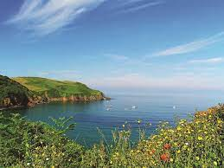
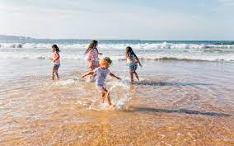
Geography: Why do we love being beside the sea so much?
Subject Specific Vocabulary |  |  | By the end of this unit, I will be able to answer these questions:
Countryside | Land not in towns, cities, or industrial areas, that is either used for farming or left in its natural condition.
Countryside | Land not in towns, cities, or industrial areas, that is either used for farming or left in its natural condition. |  | How is the seaside different from other places? How do people enjoy themselves at the seaside? What can you find in rock pools? Why do we love being beside the sea so much? How do people affect the beach? How have our seaside holidays changed since the 1970s?
City | A large town that usually has a cathedral.
Seaside | Where the land meets the sea.
Town | A busy area that is bigger than a village with many buildings and people. | Key objectives:
Urban | Anything found in large towns and cities | Identify and describe the main physical and human features of seaside environments; Provide reasons as to why it is important to protect living things at the seaside; Describe popular activities undertaken at the seaside; Identify, describe and categorise living things within a rock pool habitat; Describe and explain how people can take greater care of the seaside environment; Describe and explain reasons why seaside holidays have changed in living memory; Compare and contrast modern day experiences of the seaside with those of older members of their families or the Victorians.
Rural | Everything linked to places in the countryside
Coast | The boundary where the land meets the sea.
Habitat | The place where plants and animals find the food, water and shelter they need to live

Slide 2
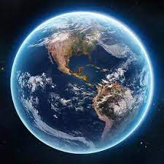
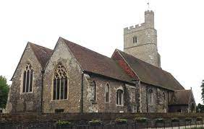
RE – Creation story: Does God want Christians to look after the world?
Subject Specific Vocabulary |  |  | By the end of this unit, I will be able to answer these questions:
Christian | A person who believes in God and lives their life following his messages and ideas. |  | How does it feel to create something? How should we treat things that others have created? How do Christians believe the earth was made? Do Christians think God wants them to look after the world? How do you think people should treat the world?
Bible | An important book to Christians. It tells stories about God and Jesus and teaches Christians how to follow God.
Create | To make something
Religion | A religion is a set of beliefs that is held by a group of people. The beliefs are about the world and the people in it, about how they came into being, and what their purpose is. These beliefs are often linked to supernatural beings such as God, a number of gods or spirits. | Key Skills
 |  | We are learning to re-tell the Christian Creation story and to explore how this influences how Christians behave towards nature and the environment.
Christian story of creation | How the earth was made

Slide 3
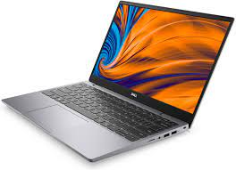
Year 1 : Computing systems and networks – Technology around us
Subject Specific Vocabulary |  | Software and Tools | By the end of this unit, I will be able to answer these questions:
Technology | Technology is the use of knowledge to invent new devices or tools. | Laptop with mouse Word programme E-Safety Copyright and Ownership I can explain why work I create using technology belongs to me I can say why it belongs to me (e.g. ‘I designed it’ or ‘I filmed it’’). I can save my work under a suitable title or name so that others know it belongs to me (e.g. filename, name on content). I understand that work created by others does not belong to me even if I save a copy Health, Well-being and Lifestyle I can explain rules to keep myself safe when using technology both in and beyond the home. | What is technology?
Computer | A computer is a device for working with information.
 |  |  | What is a computer and what are its main parts?
Mouse | A computer mouse is an input device that is used with a personal computer. Moving a mouse along a flat surface can move the on-screen cursor to different items on the screen. |  | To identify a computer and its main parts
 |  |  | How can a mouse be used?
 |  |  | How do I write on a computer?
Keyboard | The keyboard is used for entering data into the computer system. It can type words, numbers and symbols. Buttons on the keyboard are called keys. |  | How can a mouse be used?
 |  |  | How do I edit text?
 |  |  | How can we make sure we use technology responsibly?
Unit Overview: Technology around us Recognising technology in school and using it responsibly

Slide 4
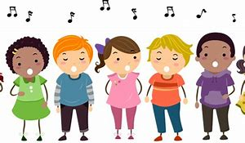
Music: Introducing beat
Subject specific vocabulary
Dynamics | Varying levels of volume of sound in different parts of a musical performance.
Pitch | How long or high the sound is.
Tempo/ tempi | The speed at which a passage of music is or should be played.
Movement | A slight movement of the body.
Beat | A rhythmic movement, or is the speed at which a piece of music is played.
Performing | Present a form of entertainment to an audience.
Key Objectives
● Demonstrate a basic understanding of how feelings can connect with/relate to music. ● Demonstrate some basic understanding of musical style. ● Demonstrate an awareness of pulse/beat when listening, moving to and performing music. ● Demonstrate an understanding and use of basic differences in pitch (high and low) and note duration (long and short). ● Demonstrate a basic understanding of the importance of posture and technique when performing. ● Demonstrate an understanding of the basic concepts of improvisation and composition.
By the end of this unit, I will be able to answer these questions:
What is a pulse/beat? What is pitch? What is note duration?

Slide 5
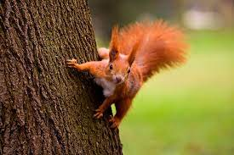
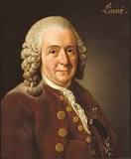
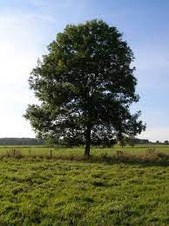
Year 1: Plants and animals where we live
Subject Specific Vocabulary |  | Working Scientifically | By the end of this unit, I will be able to answer these questions:
Animal | A living thing that breathes and can move around on its own. | * Ask simple questions and recognise that they can be answered in different ways. * Observe closely, using simple equipment. * Perform simple tests. * Identify and classify. * Use their observations and ideas to suggest answers to questions. * Gather and record data to help in answering questions.
 |  |  | Plants How can we identify and name a variety of common wild and garden plants, including deciduous and evergreen trees? What is the basic structure of a variety of common flowering plants, including trees?
Bird | Living things that have feathers, wings, lay eggs and are warm blooded. |  | Some trees can live for thousands of years.
Fish | Living things that breathe in water
Plant | A living thing, for example, trees, shrubs, herbs and grasses
 |  |  | Animals (including humans) How are common animals identified and grouped? What is the difference between carnivores, herbivores and omnivores? How do the structures of a variety of common animals differ?
Tree | Trees are tall, woody plants and they have a stem called a trunk. | Famous Scientist: Botanist Carl Linnaeus

Slide 6
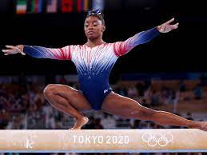
Year 1: PE- Gymnastics
Subject Specific Vocabulary- Key Words
Equipment | the necessary items for a particular purpose.
Travel | To go from one place to another
Speed | the rate at which someone or something moves
Key Skills- Objectives
1) Learn to create a variety of shapes using different parts of the body.
2) Begin to put shapes together to create a sequence.
3) Learn how to move around an area at high and low levels.
4) Learn different ways of using hands and feet to travel around.
5) Learn how balance in a variety of ways.
6) Learn how to use apparatus safely and create a small routine.
Team Work/ Fair Play
Being open and honest
Always supporting each other
Trust and respect each other
Famous People
Nadia Comaneci – the first lady to score a perfect 10 in the Olympics
Max Whitlock: With fourteen medals and six titles in Olympic and world championships, Whitlock is the most successful gymnast in his nation's history.

Slide 7
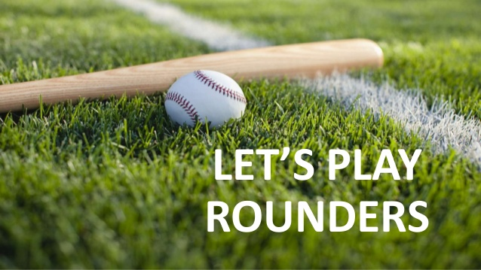
Year 1: PE- Rounders
Subject Specific Vocabulary- Key Words
Eye contact | Visual contact with another person’s eyes.
Watch | Look at or observe attentively over a period of time.
Aim | Point or direct at a target.
Key Skills- Objectives
I can learn to perform a two handed catch with the correct technique for striking and fielding games. I can learn to link throwing and catching to a bowling technique. I can make a striking action and to make contact with an object. I can learn running skills and experiment with speed. I can chase the ball and pick up the ball whilst on the move. I can understand the basic rules and positions and play modified games.
Team Work/ Fair Play
Fair Play is an essential value in tennis.
Fair Play includes: Good sportsmanship, honesty and respect whether you win or lose.
Famous People
Paris Musgrove – plays for England 2020
Freya Munson – was England Under 14 Squad Captain
Tia Norton – main bowler for England Under 16 Rounders team

Slide 8
Year 1: PSHE Knowledge Mat Zones of Regulation
Subject Specific Vocabulary |  | Key Skills/Objectives | Lines of Enquiry
The Zones | A system to categorize how the body feels and emotions into four coloured Zones with which a person can easily identify. | I can identify a range of emotions and am beginning to read my own body’s cues to determine emotions that I am experiencing. I understand how my behaviour affects me and how other people feel about me. I am beginning to identify triggers that influence my behaviours. I can use tools to regulate myself when I am experiencing intense emotions. | How do I feel in each zone?
Self-regulation | The ability to understand and manage your behaviour and your reactions to feelings and thing happening around you. |  | Which zone am I in?
 |  |  | Which tools can I use to help me get back to the Green Zone?
Blue Zone | Blue Zone is used to describe when a person feels sad, tired, sick, or bored.
Green Zone | Green Zone is used when someone is described as being calm, happy, focused, or content. When you are in the Green Zone you are ready to learn and to help others.
Red Zone | This is when someone is feeling anger, rage, explosive behaviour, panic, extreme grief, terror, or elation when in the Red Zone and feels a loss of control.
Yellow Zone | A person may be experiencing stress, frustration, anxiety, excitement, silliness, or fear when in the Yellow Zone. The person’s energy is elevated yet he or she feels some sense of internal control in the Yellow Zone.

Slide 9
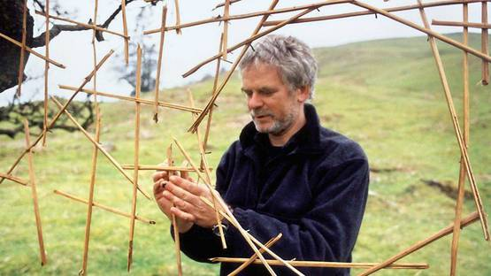
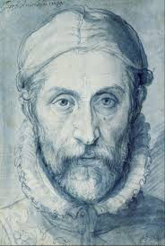
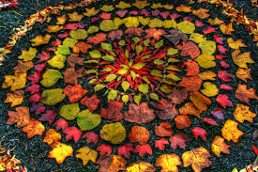
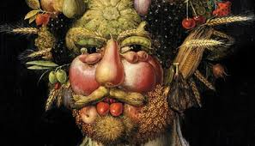
Art – How can we create art from nature?
Subject Specific Vocabulary |  |  | By the end of this unit, I will be able to answer these questions:
Sculpture | A piece of 3D art that is an object. |  | When was Giuseppe Arcimbolodo alive? How did Giuseppe Arcimboldo use animals, fruit and vegetables to create art? Who is Andy Goldsworthy and what does he do? What is a sculpture and what can it made from? What are the differences and similarities between the work of Goldsworthy and Arcimboldo? What do I think of my own art work and how could I improve it?
Natural materials | A natural material is anything that comes from plants, animals, or the ground.
Artist | A person who creates paintings or drawings as a job or hobby.
Giuseppe Arcimboldo | An Italian painter who painted portraits made out of fruit, animals and vegetables | Key Skills I can explore differences and similarities in the work of artists
Andy Goldsworthy | A British sculptor who creates art from natural objects. | Sculpture - I can make a model using natural and/or man made materials.
Model | Making an object using materials. | Art in Context - I can describe how my own work is similar and/or different to the work of well-known artists and designers.
Evaluate | To look at something and decide what you like or dislike about it. | Developing and Applying Ideas – I can show my ideas and imagination through drawing, painting or sculpture.
Compare | To look at two or more things and say what is the same or different. | Independent Artist - I can help prepare and clear away my work area.
Photographer | A person whose job it is to take photographs
Portrait | A painting, drawing or photograph of someone's face.

