Slide 1
RE – Was it always easy for Jesus to show friendship?
Subject Specific Vocabulary |  |  | By the end of this unit, I will be able to answer these questions:
Friendship | A relationship between friends. |  | Do Christians believe that Jesus was nice to people? Can you talk about your friends and why you like them? How did Jesus show friendship through the Bible? How do you think you have been a good friend? How do Christians show friendship and how does God help them to do this?
The New Testament | The second part of the Christian Bible.
Incarnation | Jesus is God in the flesh, and that, in Jesus, God came to live among humans.
Feelings | An emotional state or reaction. | Key Skills
 |  | We are learning to identify when it is easy and difficult to show friendship and explore when Jesus may have found it difficult.
Stories | A story is a description of an event or something that happened to someone.

Slide 2
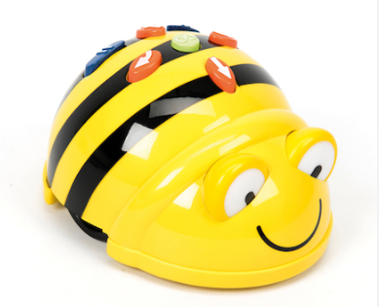
Year 1 : ICT- Programming a moving robot
Subject Specific Vocabulary |  | Software and Tools | By the end of this unit, I will be able to answer these questions:
Command | Control over something. | We are learning to explore using individual commands, both with other learners and as part of a computer program. We will identify what each floor robot command does and use that knowledge to start predicting the outcome of programs. We are also introduced to the early stages of program design through the introduction of algorithms. | What is a given command?
Programme | To tell a device or system to operate in a particular way.
 |  |  | What is a direction?
Debug | To remove bugs from a computer programme. |  | To identify a computer and its main parts
 |  |  | How do I combine commands to make a sequence?
 |  |  | How do I command a robot to move?
Algorithm | A list of instructions for solving a problem.
 |  |  | How do I debug a programme?
Direction | The position towards which someone or something moves or faces. |  | How do I debug a programme?
 |  |  | How do I plan two programme?
Unit: Programming a robot Online safety: Privacy and security I can explain how passwords are used to protect information, accounts and devices. I can recognise more detailed examples of information that is personal to someone (eg where someone lives and goes to school, family names) I can explain why it is important to ask a trusted adult before sharing any personal information online, belonging to myself or others. |  |  | How do I plan two programme?

Slide 3
Music: Introducing tempo and dynamics
Subject specific vocabulary
Dynamics | Varying levels of volume of sound in different parts of a musical performance.
Pitch | How long or high the sound is.
Tempo/ tempi | The speed at which a passage of music is or should be played.
Beat | A rhythmic movement, or is the speed at which a piece of music is played.
Performing | Present a form of entertainment to an audience.
Key Objectives
● Demonstrate a basic understanding of how feelings can connect with/relate to music. ● Demonstrate some basic understanding of musical style. ● Demonstrate an awareness of pulse/beat when listening, moving to and performing music. ● Demonstrate an understanding and use of basic differences in pitch (high and low) and note duration (long and short). ● Demonstrate a basic understanding of the importance of posture and technique when performing. ● Demonstrate an understanding of the basic concepts of improvisation and composition.
By the end of this unit, I will be able to answer these questions:
What is a pulse/beat? What is pitch? What is note duration?

Slide 4
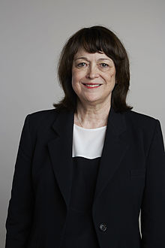
Year 1: Science- Who am I?
Subject Specific Vocabulary |  | Working Scientifically | By the end of this unit, I will be able to answer these questions:
Backbone | The bones that run along the centre of the back; this is also called the spine | Observe closely, using simple equipment. Identify and classify. Gather and record data to help in answering questions.
 |  |  | Can you name a wide range of body parts? What are the senses and can you discuss which part of the body they are linked to? Can you observe using your senses? How many senses do we have and can you name all of them?
Ear lobe | The fleshy part at the bottom of the ears
Elbow | The joint between our upper arm and forearm; it is where we bend our arm
Eye socket | Part of the skull where the eye fits
Hips | Help humans to support the weight of their body when they are standing or moving about; they help us to balance | Famous Scientist: Linda Buck
Joints | Where bones meet, e.g. knee, elbow, shoulder, hips, ankle
Ribs | The set of bones that curve from the spine round to the chest
Thigh | Part of the leg that goes from the knee to the hip
Vertebrae | Small bones that make up the backbone
Nail | A thin, hard material covering the end of the fingers and toes
Tongue | The tongue is a muscle that is used for tasting, eating, swallowing and talking

Slide 5
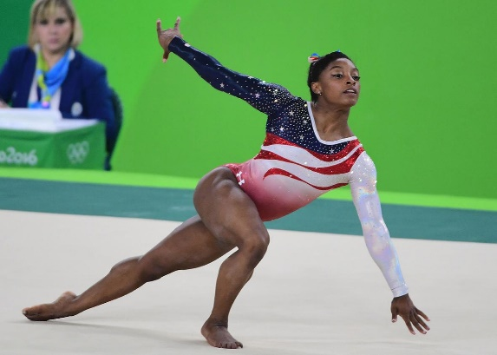
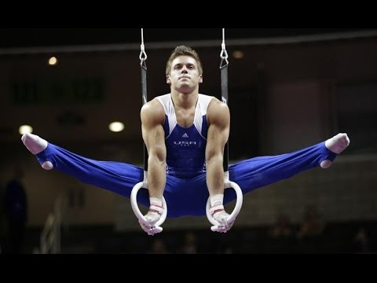
Year 1: PE- Gymnastics
Subject Specific Vocabulary- Key Words
Posture | The position in which someone holds their body when standing or sitting.
Absorb | Take in or soak up a physical action
Compare | Point out or describe the similarity or dissimilarity between things
Balance | An even distribution of weight enabling someone or something to remain upright and steady.
Patch Balance | Uses large body parts such as legs, back, stomach to balance.
Point Balance | Using a small body part such as feet, hands, head or knees to balance
Key Skills- Objectives
I can create different shapes using my body.
I can link shapes into a small sequence.
I can move around an area at different levels.
I can learn how hands and feet are used to help movement.
I can perform a variety of balances.
I can create a small routine using apparatus.
Team Work/ Fair Play
Fair Play is an essential value in tennis.
Fair Play includes: Good sportsmanship, honesty and respect whether you win or lose.
Local Clubs
FireFields
Gillingham Gymnastics Club
Jumpers Rebound Centre
Famous People
Simone Biles
Beth Tweddle
Max Whitlock
Louis Smith

Slide 6
Year 1: PE- Football
Subject Specific Vocabulary- Key Words
Eye contact | Visual contact with another person’s eyes.
Watch | Look at or observe attentively over a period of time.
Aim | Point or direct at a target.
Key Skills- Objectives
I can learn to perform a two handed catch with the correct technique for striking and fielding games. I can learn to link throwing and catching to a bowling technique. I can make a striking action and to make contact with an object. I can learn running skills and experiment with speed. I can chase the ball and pick up the ball whilst on the move. I can understand the basic rules and positions and play modified games.
Team Work/ Fair Play
Fair Play is an essential value in football.
Fair Play includes: Good sportsmanship, honesty and respect whether you win or lose.
Famous People
Cristiano Ronaldo
Kyle Walker
Jill Scott

Slide 7
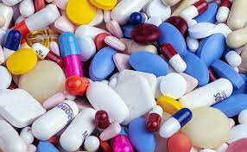
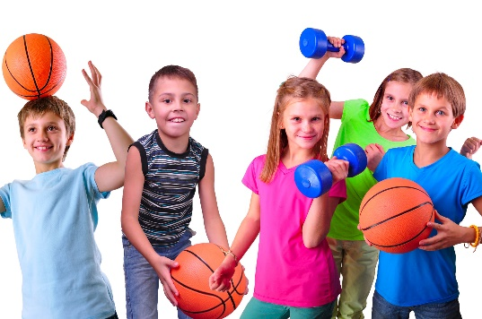
Year 1: PSHE Knowledge Mat Keeping Safe
Subject Specific Vocabulary |  |  | By the end of this unit, I will be able to answer these questions:
Sleep | To be in the state of rest for the body and mind in which the eyes are closed and one is not fully conscious |  | What can I do if I have strong, but not so good feelings, to help me stay safe?
Exercise | Playing and being physically active.
Medicine | A drug or other substance used to treat a disease, injury, pain, or other symptoms. | Key objectives: | How can I keep myself healthy?
 |  | How many different feelings can people have? Do different feelings make your body feel different? What can you do if you have ‘not so good’ feelings? How can you help if someone else has ‘not so good’ feelings? What do people need to keep healthy? How do you keep yourself healthy? Why do we need different things to be healthy? How do medicines help? Are medicines always helpful? Where do medicines need to be kept? Why? | When are medicines harmful?
Body | The human body is a combination of parts and systems that work together to perform the necessary functions of life.
Uncomfortable | To feel uneasy

Slide 8
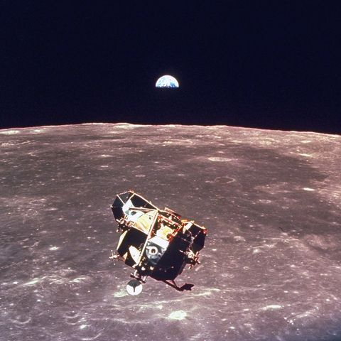
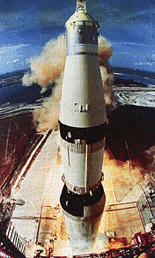
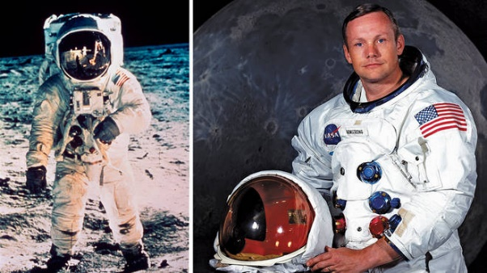
History – What is out there? - KS1 Knowledge Mat
Subject Specific Vocabulary |  |  | By the end of the unit I will be able to answer these questions:
Apollo 11 | The rocket which went to the moon |  | Who was the first astronaut in space? Who is Neil Armstrong and what did he do? Can you sequence the events in the build up to the first man landing on the moon? Who else has travelled to Space? Did you know that there was a Race to Space?
The Eagle | The capsule which actually landed on the moon
Rocket | A spacecraft that obtains thrust from a rocket engine.
Russia | A country in Eastern Europe involved in the space race. | Key Skills
USA | A country in North America involved in the space race. | •Briefly describe features of particular historical themes, events and people from family, local, national and global history. •Depict on a timeline the sequence of events which led to the first landing on the moon. •Consider why an event, person or place might be significant.
Orbit | The curved journey of a planet, star or space craft around an object in space.
Spacesuit | A specialised suit to protect astronauts in space.
Timeline | A chronological or ‘time order’ list of events.

Slide 9
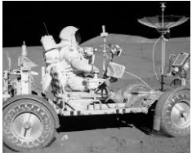
Year 1: To Infinity and Beyond (DT)
Subject Specific Vocabulary |  | Key Skills | By the end of this unit I will be able to answer these questions:
Design | To make or draw plans of a product to be made. | Evaluate an existing or own product, saying what they like, do not like and suggest improvements. | How do space related vehicles work? How have space related vehicles been used? What is a moon buggy? What are the features of a moon buggy? Which materials would be best to use when designing and building a moon buggy? How can I create moving joins?
Tools | A piece of equipment that you hold in your hands and use to do a particular kind of work.
 |  | Design for purpose, a moon buggy using a labelled drawing.
Evaluate | To look at and think about something to decide whether it fits the purpose or criteria.
Materials | Anything used for building or making something else. | Choosing suitable materials for purpose.
Joining | To put, bring, fix or fasten together.
 |  | Use a range of materials, tools and joining methods to create a product.
Purpose | The reason for which something exists.
 |  | * To know how to create fixed and moving joins in order to create windscreen wipers on the buggy or a moving steering wheel.
Template | A thin piece of material cut into a particular shape. It is used to help you cut accurately or reproduce the same shape many times.

