Slide 1
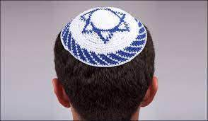
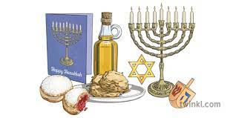
RE – Judaism: Is Shabbat important to Jewish children?
Subject Specific Vocabulary |  |  | By the end of this unit, I will be able to answer these questions:
Jew | A person whose religion is Judaism |  | What is my favourite day of the week? What special food would I like to share in a special meal? What is Shabbat? What are the names for things that are special to Jewish people during Shabbat? Why are they special? Is there a connection between being Jewish and decisions about behaviour?
Judaism | The religion of Jewish people
Shabbat | The day of the week set aside for worship and rest
Synagogue | A place of worship for people of the Jewish religion | Key Skills
 |  | We are learning to empathise with Jewish children by understanding what they do during Shabbat and why it is important to them.
Kippah | Skull cap

Slide 2
RE Term 5 Sticky Knowledge
Shabbat is the day of the week set aside for worship and rest.
The Sabbath or Shabbat (the Hebrew word for ‘Sabbath’) is the seventh day of the week.
Jewish people celebrate the Sabbath every week.
The Sabbath begins at sunset on Friday and lasts until nightfall on Saturday.Jewish people look forward to Shabbat as it is a time for resting. Time is spent eating and relaxing with family and friends.

Slide 3
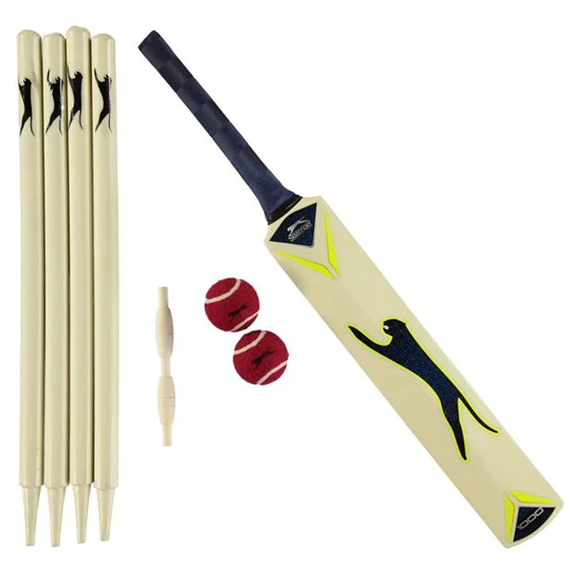
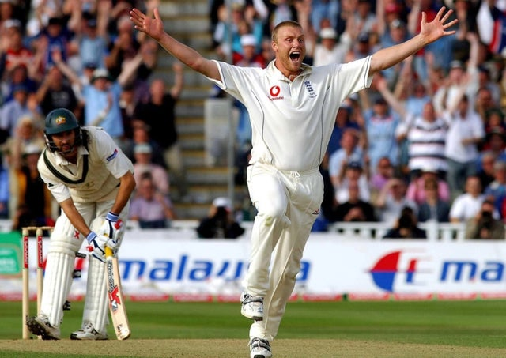
Year 1: PE – Kwik Cricket
Subject Specific Vocabulary – Key words
Opposite leg to throwing arm | Follow through with arm
Point at target | Wicket Keeper
Body position | Track ball
Move feet | Catching zone
Hands out to receive ball | Attack the ball
Runs | Caught
Batter | Bowler
Key Skills - Objectives
I can apply fundamental beanbag skills, focussed on throwing
I can carry out basic underarm bowling/throwing with tactics and aspects of fielding
I can develop my catching and fielding skills
I can field a ball and return it to the wicket
I can learn the basic concept of playing a Kwik Cricket game
I can develop the basic concept of playing a Kwik cricket game
I can show an understanding of the health benefits of exercise.
Rules of the game
Split the class into 2 teams. 1 team are batters and 1 group are fielders.
You need 1 bowler who throws the ball under arm to the batter.
The batter must hit the ball and run with the bat
The batter must run to the stumps and back to the batting position
Fielders run to retrieve the ball and must return it to the bowler before the batter is back to his batting position.
The team with the largest number of runs win the game of Kwik cricket.
Local Clubs
Upchurch Cricket Club
Rainham Cricket Club
Lower Halstow Cricket Club
Lordswood Cricket Club
Team Work / Fair Play
Fair Play is an essential value in all sport.
Fair Play includes: good sportsmanship, honesty and respect whether you win or lose.
Famous People/Teams
Freddy Flintoff
Ian Botham
Shane Warne
Kevin Pietersen.

Slide 4
PE Term 5 Sticky Knowledge
I know that cricket is a game played between two teams.
You need 1 bowler who throws the ball under arm to the batter.
The batter must hit the ball and run with the bat
The batter must run to the stumps and back to the batting position
Fielders run to retrieve the ball and must return it to the bowler before the batter is back to his batting position.
The team with the largest number of runs win the game of Kwik cricket.

Slide 5
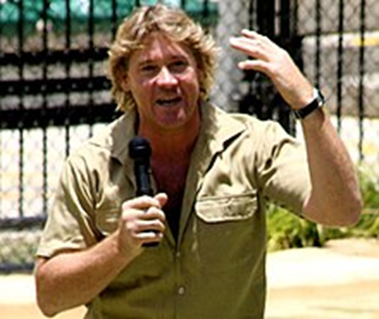
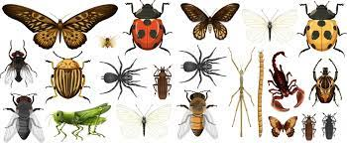
Year 1: Science- On Safari
Subject Specific Vocabulary |  | Working Scientifically | By the end of this unit, I will be able to answer these questions:
Abdomen | The third last part of an insect. It’s the stomach of the insect. | Ask simple questions and recognise they can be answered in different ways. Perform simple tests. Identify and classify. Gather and record data.
 |  |  | What is an invertebrate? Can you name some common plants? What would you take on safari? What do insects look like? Do invertebrates live in the same places? Do invertebrates have hairs? Where are legs on an invertebrates body? What body parts are on a insect? What do invertebrates eat? What do snails eat? How do snails move?
Exoskeleton | The outside, hard part of a body that protects.
Food chain | The order that things are eaten in.
Habitat | Where an animal lives.
Insect | Invertebrates that have three main body parts and three pairs of legs. | Famous Scientist: Steve Irwin
Invertebrate | Animals with no back bone.
Thorax | Middle part of an insects body that has the legs on.
Vertebrate | Animals that have backbones.
w

Slide 6
Science Term 5 Sticky Knowledge
An invertebrate is an animals with no back bone.
I can recognise and name some common plants like daisies, roses and buttercups.
Insects are invertebrates that have three main body parts and three pairs of legs.
Invertebrates live on land and in the water, or even both.
Invertebrates do not have hairs.
What body parts are on a insect?

Slide 7
Music: Having fun with improvisation. What songs can we sing to help us through the day?
Subject specific vocabulary
Improvisation | to make something up on the spot, or figure it out as you go.
Pitch | how long or high the sound is.
Rhythmn | long and short sounds or patterns that happen over the pulse, the steady beat
Performing | present a form of entertainment to an audience.
Improvise | create and perform (music, drama, or verse) spontaneously or without preparation.
Compose | write or create a work of art, especially music or poetry
Key Objectives
● Demonstrate an awareness of pulse/beat when listening, moving to and performing music. ● Demonstrate an understanding and use of basic differences in pitch (high and low) and note duration (long and short). ● Demonstrate a basic understanding of the importance of posture and technique when performing. ● Demonstrate an understanding of the basic concepts of improvisation and composition. ● Introduce the performance (any connection to the Social Theme is an added bonus). ● Beginning to create personal musical ideas using the given notes for this unit. ● Following a steady beat and staying ‘in time’. ● Understanding that improvisation is about making up your own very simple tunes on the spot.
By the end of this unit, I will be able to answer these questions:
What does improvise mean? How does music make me feel?? What does “in time “ mean? What is composition? How should you stand when performing?

Slide 8
Music Term 5 Sticky Knowledge
Improvise means to make something up on the spot, or figure it out as you go.
I can recognise and describe how music makes me feel.
I know that different music can make you feel different ways.
To compose is to write or create a work of art, especially music or poetry
When you perform you should stand up straight and look forwards.

Slide 9
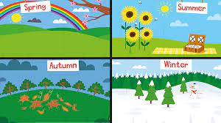
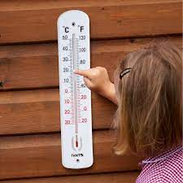
Year 1: Geography- How does weather affect our lives?
Subject Specific Vocabulary |  |  | By the end of this unit, I will be able to answer these questions:
 |  |  | What is weather? How does weather change over the seasons? How can we measure temperature? How can we measure the wind? Why are some places hot and some places cold? What is weather like near the equator? What is weather like near the North and South pole?
Temperature | A measurement of how hot or cold something is.
Tornado | A huge tube of air that spins quickly and powerfully.
Drought | A shortage of rain over a long period of time and the earth dries and plants and animals die.
Thermometer | A piece of equipment used to measure temperature.
Rain gauge | A way of measuring how much rain had fallen. | Key objectives:
Weather vane | A piece of equipment used to see what direction the wind is | • Identify and describe the basic atmospheric elements of the weather; • Observe, measure and record the elements of daily weather by using a variety of simple instruments and devices; • Present, describe and offer reasons for some of the ways in which the weather has changed during the period of measurement; • Identify, describe and begin to explain ways in which great artists depict elements of the weather and the techniques they use to convey noise, smell and emotional feelings; • Observe how weather conditions change during the four seasons of the year and offer reasons for changes which occur; • Observe and offer reasons for the distribution of hot and cold places in the world;
Seasons | The seasons are four different times during the year with different types of weather. The four seasons are called spring, summer, autumn, and winter.
Equator | An imaginary line that runs around the centre of the earth. It is the hottest place on earth.

Slide 10
Geography Term 5 Sticky Knowledge
I know that there are different types of weather, for example, rain, sun, wind, thunder, lightning.
I know that each season brings different types of weather, for example, it is colder and windier in the winter and warmer and sunnier in the summer.
We can measure temperature using a thermometer.
We can find out the direction of the wind using a weather vane.
Some places hot and some places cold due to how close they are to the equator.
Near the equator, the weather is warm.
The weather near the North and South pole is cold.

Slide 11
Year 1 :Creating media – Digital writing
Subject Specific Vocabulary |  | Software and Tools | By the end of this unit, I will be able to answer these questions:
Text | A set of words that has meaning. | Laptop with mouse Word programme E-Safety Self-Image and Identity I can recognise that there may be people online who could make me feel sad, embarrassed or upset. I know when I should ask an adult for help with things online that upset me. I can give examples of different adults I can ask for help. | What is a keyboard and what keys are on the keyboard?
Computer | A computer is a device for working with information.
 |  |  | How can I add and remove text?
Toolbar | A strip of icons on a computer display providing quick access to certain functions |  | What is a toolbar?
 |  |  | What tools can I use?
Keyboard | The keyboard is used for entering data into the computer system. It can type words, numbers and symbols. Buttons on the keyboard are called keys. |  | How can a mouse be used?
 |  |  | How is writing on a computer different to writing on paper?
Unit Overview: Creating media – Digital writing Promote your learners’ understanding of the various aspects of using a computer to create and change text. Learners will familiarise themselves with typing on a keyboard and begin using tools to change the look of their writing, and then they will consider the differences between using a computer and writing on paper to create text.

Slide 12
ICT Term 5 Sticky Knowledge
What is a keyboard and what keys are on the keyboard?
I know what a keyboard and what keys are on the keyboard.
I know that the keys are capitals and not in alphabetical order.
I can add or remove text using the letter keys and the backspace button.
I know what the toolbar is and where to find it.
I know that writing on a computer is different to writing on paper.
I can recognise that there may be people online who could make me feel sad, embarrassed or upset.
I know when I should ask an adult for help with things online that upset me.
I can give examples of different adults I can ask for help.

Slide 14
DT Term 5 Sticky Knowledge
I know that you can join different components together in different ways.
I know that it will help me to make a product if I research existing products first.
I know that evaluating my product will help me to learn from my successes and my mistakes.
I know that I can use slits to help me join two components together.
I know that if I laminate a piece of paper then it will become waterproof.

Slide 15
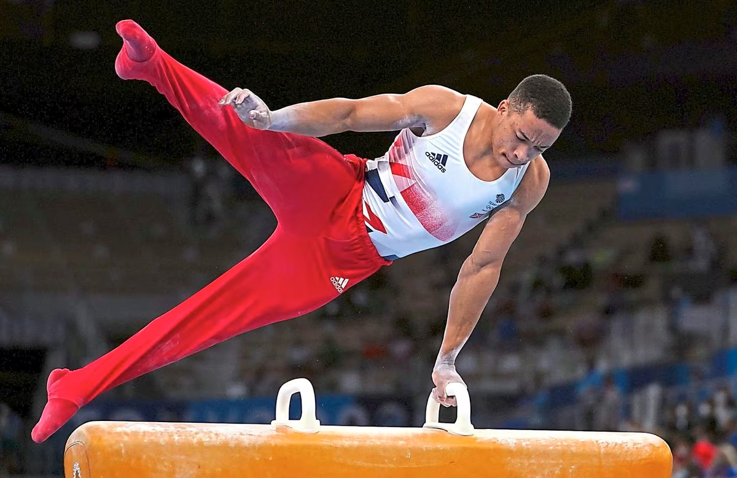
Year 1: PE- Gymnastics Get Set 4 PE
Subject Specific Vocabulary- Key Words
Apparatus | a piece of equipment that's used in gymnastics
Balance | the ability to maintain a controlled body position during task performance
Sequence | a set of related movements that follow each other in a particular order
Key Skills- Objectives
To explore travelling movements.
To develop quality when performing and linking shapes.
To develop stability and control when performing balances.
To develop technique and control when performing shape jumps.
To develop technique in the barrel, straight and forward roll.
To link gymnastic actions to create a sequence.
Team Work/ Fair Play
Observing and give feedback
Always supporting each other
Trust and respect each other
Famous People
Beth Tweddle MBE is a retired British artistic gymnast. Renowned for her uneven bar and floor routines, she was the first female gymnast from Great Britain to win a medal at the European Championships, World Championships, and Olympic Games
Joe Fraser is an English artistic gymnast. He is the 2022 European all-around and parallel bars champion and the 2019 world champion on the parallel bars, the first British gymnast to ever win gold in any of these events.

Slide 16
PE Term 5 Sticky Knowledge
I know there are different ways to travel and I can explore travelling movements.
I can perform and link shapes.
I know how to be stable and have control when performing balances.
I can show control when performing shape jumps.
I can perform the barrel, straight and forward roll.
I can link gymnastic actions to create a sequence.

Slide 17
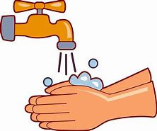
Year 1: PSHE Knowledge Mat Being my Best
Subject Specific Vocabulary |  |  | By the end of this unit, I will be able to answer these questions:
Personal hygiene | The way we care for our bodies. |  | What is the importance of fruit and vegetables in my daily diet?
 |  |  | Which foods do we need to eat more of and which we need to eat less of to be healthy?
Healthy | Being well and fit. |  | Some trees can live for thousands of years.
Disease | Conditions that make people unhealthy. | Key objectives:
 |  | Know that eating at least five portions of vegetables and fruit a day helps to maintain health. Recognise that they may have different tastes in food to others; Recognise the importance of regular hygiene routines; Sequence personal hygiene routines into a logical order. Recognise and use simple strategies for preventing the spread of diseases. Recognise that learning a new skill requires practice and the opportunity to fail, safely; Demonstrate attentive listening skills; Give and receive positive feedback, and experience how this makes them feel. | Why are regular hygiene routines so important?
Skills | Ability that comes from training or practice |  | How do diseases spread?
Feelings | An emotion. |  | What do I need to do to learn a new skill?
Conflict | A struggle between people which may be physical, or between conflicting ideas.
 |  |  | How can we resolve conflict situations?

Slide 18
PSHE Term 5 Sticky Knowledge
I know that eating at least five portions of vegetables and fruit a day helps to maintain health.
I recognise that I may have different tastes in food to others
I recognise the importance of regular hygiene routines
I recognise and can use simple strategies for preventing the spread of diseases.
I recognise that learning a new skill requires practice and the opportunity to fail, safely.
I know how to listen attentively
I can give and receive positive feedback, and experience how this makes me feel.

Slide 19
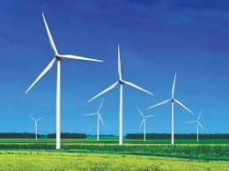
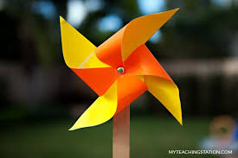
Year 1: DT How can we join materials and components ?
Subject Specific Vocabulary |  | Key Skills | By the end of the unit I will be able to answer these questions.
Materials | What something is made of. | Select appropriate tools and equipment for the purpose. | What is renewable energy? What is a wind farm? How does a wind turbine work and move? How can we join components? Why must we research products before we make them? Why do we evaluate our work?. Which material is suitable for the job and why? How can we make a moving join?
Components | Many parts that make a whole product.
 |  | Say whether the product does what it is meant to (fits the design brief) and how it could be improved
Evaluate | To think about a product and say what was good or bad about it.
 |  | Use materials and construction tools, components with appropriate supervision.
Design | A plan of what you want to make. | Mark and cut materials and components.
Wind farm | An area of land with a group of energy-producing windmills or wind turbines.
 |  | Talk about own and pre-existing products, exploring, who, what and where and how. Saying what is good or bad about them.
Meteorologist | Someone who studies the weather.
Join | Combine materials or parts together. | Think of own ideas for designs.
Split pin | a metal cotter pin with two arms passed through a hole, held in place by the springing apart of the arms.

