Slide 1
Welcome to the Year 5 ‘Meet and Greet’

Slide 2
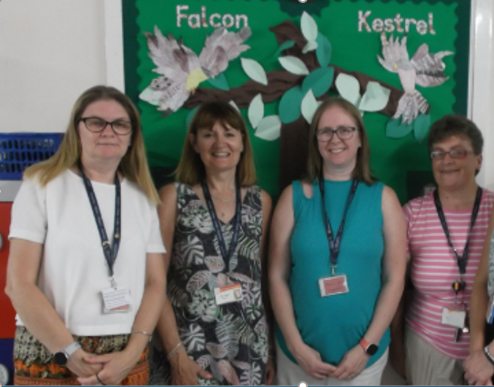
The Year 5 Team
Mrs Gillam
Mrs Mead
Falcon
Mrs Townsend
Kestrel
Mrs Ridley

Slide 3
Year 5 Curriculum Overview
Our themes in Year 5
Terms 1-2: What happened to the Maya?
Term 3: Who are national parks for?
Terms 4-5: 1385-1603 – a period of change? (Tudor Day)
Term 6: What is a river? (River Study trip)

Slide 4
Being Prepared
PE
We expect every child to participate in PE.
Children need to be prepared by coming into school in their PE kit on the days of their PE lessons. Please make sure earrings are removed prior to coming to school on PE days.
PE Days
Indoor – Tuesday (Gym)
Outdoor - Wednesday (Hockey) Children will need tracksuit bottoms, jumper and trainers.
Water Bottles
Please ensure that your child has a named water bottle with them everyday and that it goes home to be washed every day.
Coats
Please ensure that your child has a jumper/cardigan every day and also ensure they have a warm coat as we head into winter. All items of clothing to be named, please.

Slide 5
Behaviour and Expectations
Now that your child is in Year 5, we strive for the children to be independent and resilient learners. This will help to prepare them for Year 6 and ultimately, secondary school.
Learning Points – Reasons for children earning Learning Points are: active listening, being reflective, perseverance, sharing ideas, showing curiosity and showing resilience. Learning Points will be recorded on Class Dojo.
Good To Be Green – All children start each lesson with a green card with the aim of showing good learning skills and staying on green. If children repeatedly do not show the appropriate learning behaviours, they will get a warning, their green card will change to an amber and then red card. A red card results in losing 5 minutes from a playtime. At the beginning of each session, the card resets and they have the opportunity to show good learning behaviours again.
Secret Pupil – Each day, the teacher will take a name from a box without looking. If that child has stayed on green for the whole day, the whole class receive a secret pupil point. These points can be used to pay for amounts of time for a treat at some point in the term.

Slide 6
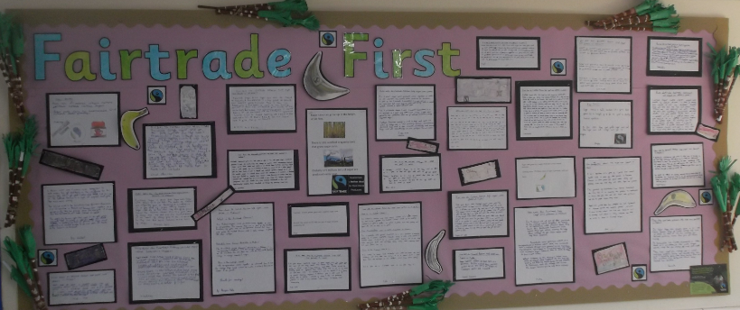
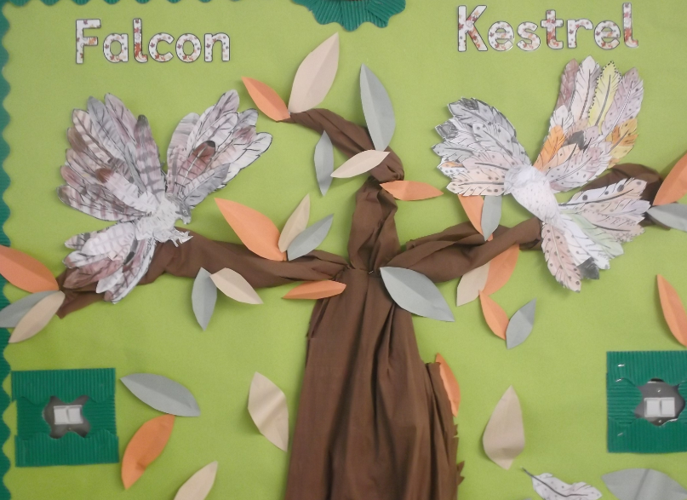
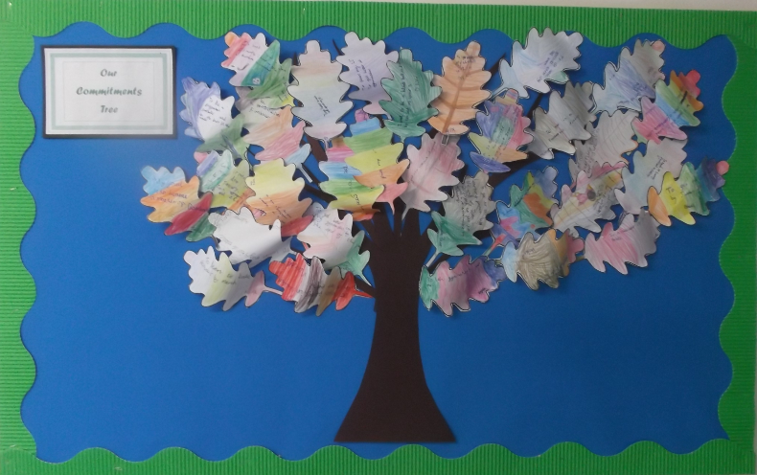
Our Learning Environment
The displays in each classroom are designed to support the children’s learning and will include children’s thoughts, questions and work. We love to celebrate children’s learning in Year 5 so you will find examples of children’s work in the classroom and around the school.

Slide 7
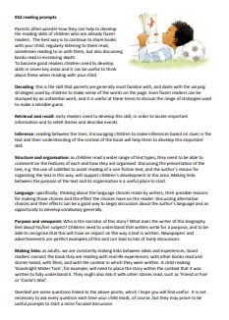
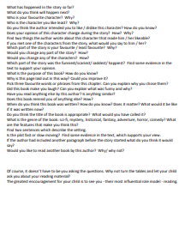

Reading
Reading is extremely important and should be taking place at home every day. This can be independent reading, sharing a book together or being read to.
Please record this in your child’s reading record. Please talk about the books and the events and characters to check your child is understanding what they have read.
Please take a copy of the question prompts to support reading at home with your child.

Slide 8
Homework
Maths and English homework will be set on Fridays – to be completed and handed in the following Wednesday.
Please return homework promptly in the folder provided so that it can be marked prior to the next piece being set.
Geography/History/Science homework is set termly. The children can choose from a selection of activities; we expect 2-3 pieces to be completed each term.

Slide 9
Thank you for coming to our Welcome Meeting – it has been wonderful to meet you all!

