Slide 1
When You Believe

Slide 2
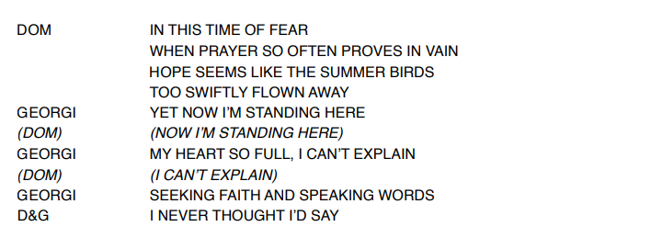

Slide 3

(Georgi introduces choirs)

Slide 4


